Slide 1
Old Lyme wastewater management project
Presented by: Carlos Esguerra and Nisha Patel
Bureau of Water Protection and Land Reuse
Water Planning and Management Division
Notes:
Good evening, everyone, my name is Carlos Esguerra. I am a Supervising Environmental Engineer with CT DEEP’s Municipal Wastewater Program which administers the Clean Water Fund program here in CT. The CWF program is the primary financial assistance program for upgrades of municipal wastewater infrastructure in the State. Nationally this program is known as the State Revolving fund program. I am joined tonight by Nisha Patel who is the Director of the Water Planning and Management Division and Ivonne Hall Assistant Director of the Municipal Wastewater program.. Thank you OLSBA for the invitation to be here tonight.

Slide 2
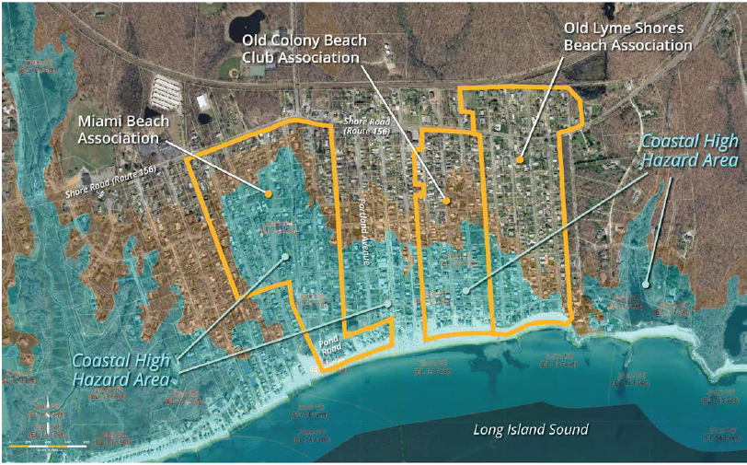
Agenda
- Project timeline
- How a septic system works
- Past evaluation of options for Planning
- Order Issuance
- Alternatives evaluated
- Cost estimate for OLSBA
-Additional cost considerations/savings
-May 24, 2025 Vote

Slide 3
Project timeline
At-a-glance
Planning
Env. Review
IMA/CSA
Consent order
Design
OLSBA 2012
OCBCA 2012
MBA 2013
Town 2015
OLSBA, OCBCA and MBA 2016
Town 2018
Cost Sharing agreement 2016
Intermunicipal
Agreement
2018/2024
OLSBA, OCBCA and MBA
2018
Bid # 1 2021
Bid # 2 2025 (Except OLSBA, MBA-no bids)
Notes:
Projects funded by the Clean Water Fund program have three main phases (Planning, Design and Construction). Once the planning phase is completed and approved, the Community would typically start design of the recommended alternative.

Slide 4
How a septic system works
The Public Health Code defines the minimum criteria for a subsurface sewage disposal system (septic system) which will protect public health and the environment.
Septic systems needs adequate vertical and horizontal separation to properly renovate wastewater.
Typical septic systems do not provide significant treatment for nutrients like nitrogen. Sewering and onsite advanced treatment units (which require constant O&M) would reduce nitrogen.
Notes:
WHY? To protect human health and the environment by removing harmful bacteria, and other pollutants from wastewater before it is released back into natural water bodies or groundwater preventing the spread of disease, maintaining clean water sources for drinking and recreation, and safeguarding aquatic ecosystems
Conventional septic systems operate best in areas where there are adequate conditions for the operation of that system (Adequate leaching area to treat wastewater, adequate separating distances from sensitive receptor such as groundwater, bedrock, watercourses). There is an inverse correlation between density of development and the capacity of the land to renovate wastewater.

Slide 5
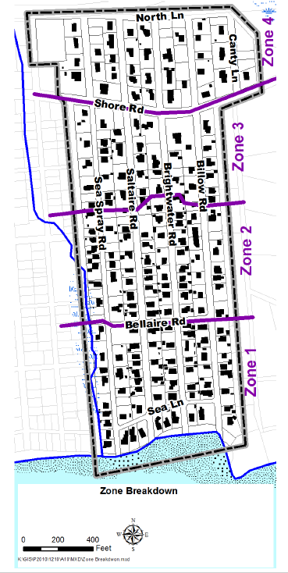
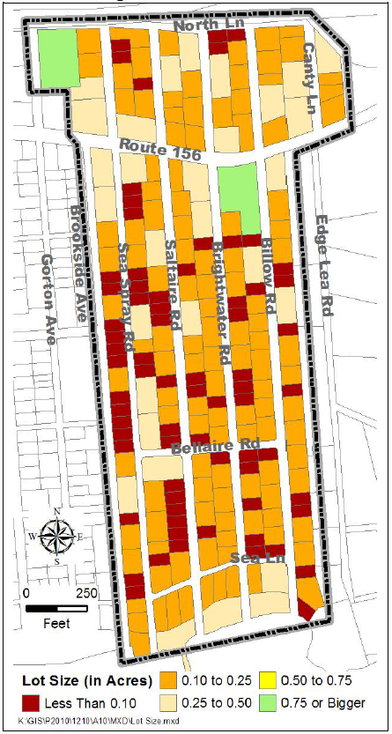
Past evaluation of options for Planning 2011 data:
High E. Coli (>600) High Enterococci (>2,500) High COD 130 mg/l
High E.Coli (>2,000) Moderate to High COD (38 to 180 mg/l) Ammonia hits
High enterococci (>1,000)
High E.Coli (>600) Ammonia hits
Note: without a change in the underlying conditions (more details on next slide), no appreciable change in the pollutant levels would occur.
Notes:
Three sampling events performed in month of August of 2011

Slide 6
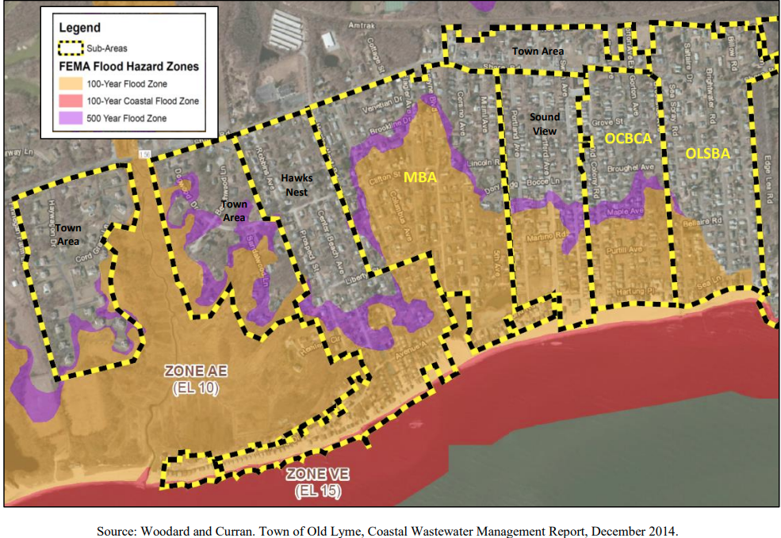
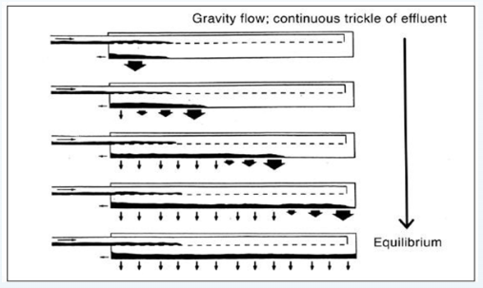
past evaluation of options for Planning findings/Evaluation criteria (continued)
Nitrogen contributes to low dissolved oxygen in LIS, which is harmful to aquatic life and significantly impact uses such as fishing, recreation, etc.
High density of development: Average number of bedrooms per acre (Approx. 13 bedrooms per acre). DPH identifies no more than 6 bedrooms/ acre.
Lot size : Over 85% of the lots within the project area are smaller than 0.25-acres with a significant number of lots smaller than 0.1-acres.
Subsurface conditions:
shallow bedrock (eastern part of OLSBA and areas closer to Rte. 156),
sandy soils with high percolation rates (< 10 minutes/inch of soil traveled)
shallow groundwater in areas closer to shoreline
-Additionally, septic systems in seasonal communities don’t function properly because constant activity is necessary for a biomat to form and sustain, and for proper system performance.
*Biomat is made up of bacteria attached soil particles. These microorganisms rely on the organic matter in the effluent for sustenance to break down pollutants. Without regular flow (year-round occupancy) parts of the biomat can dry out and degrade reducing the effectiveness of the system.
Notes:
OLSBA = 13 bdrms with densities as high as 18 to 21 bdrms/acre in SV and OCBCA. When a significant number of small lots are in a neighborhood, even the health code may be insufficient to protect health and the environment (DPH Circular Letter 2000-01)-

Slide 7
Summary of What alternatives were evaluated
1. Conventional septic system upgrades on each property:
Prevalence of small lot sizes and difficult subsurface conditions make septic system repairs difficult for a significant number of properties in project area. Also, conventional septic systems do not inherently remove nitrogen or bacteria, without additional treatment in the soil.
2. Community wastewater system: Wastewater from project area would be collected with sanitary sewers and taken to another site for treatment and disposal in the ground
Project considered the “Cherry Stones” site but it was ruled out due to existence of a community well field nearby and hydraulic/soil capacity limitations.
3. Advanced Treatment Units: Each property would be equipped with a miniature version of a wastewater treatment plant.
Ruled out due to high cost and complexity of program implementation in seasonal communities.
4. Sanitary sewers: Construction of internal gravity sewers and a shared force main and pump station.
*Selected alternative
*Non-sewer options were determined to be infeasible and unprotective
Notes:
Each property within the project area would be updated with a new conventional septic system. However considering the site conditions this option was ruled out. Septic systems would need to beengineered, many requiring exemptions from the public health code. Community system, with a communal leaching areas significantly magnifying the footprint of this system. It is also limited by how much treated wastewater can be discharged into the ground.

Slide 8
Order issuance
DEEP reviewed the reports and findings (summarized in previous slides) and determined that a pollution problem exists or can be reasonably anticipated.
DEEP issued an order requiring the implementation of the best selected alternative (sewers) based on the following authority:
Connecticut General Statutes (CGS Section 22a-423) define pollution as “…the contamination or rendering unclean or impure or prejudicial to public health of any waters of the state by reason of any wastes or other material discharged or deposited therein by any public or private sewer or otherwise so as directly or indirectly to come in contact with any waters…”
CGS SEC. 22a-428. …If the commissioner finds that any municipality is causing pollution of the waters of the state, or that a community pollution problem exists, or that pollution by a municipality or a community pollution problem can reasonably be anticipated in the future, he may issue to the municipality an order to abate pollution.
This Photo by Unknown Author is licensed under CC BY-SA
Notes:
This slide shows some statutory excerpts that give the State the authority to protect the environment and public health from pollution. When a number of properties with similar septic system deficiencies exists in a neighborhood…a community pollution problem exists or can be anticipated in the future. The CWF program exists to help communities address pollution problems related to municipal wastewater management

Slide 9
Project Costs – Sewer Project Only
Illustration of Per EDU Cost
Notes:
1. Costs are estimates for projects not bid and actual for those with bids
2. For MBA and OLSBA, estimates are bid-adjusted
3. This table includes:
Capital costs (public ROW) work. It does not include: sewer lateral cost (capital cost ~$7,000 to 15,000 per property), annual O&M cost of ~$450/yr). Note that tie-in costs to New London are included here. This includes a contingency of 10% (2x 5% contingency typically used)
4. The EDU/yr cost for sewer only: ~$2,220
Notes:
Design Costs are based on community characteristics

Slide 10
Stormwater system upgrade needs
DEEP is aware that Old Lyme Shores would like to voluntarily upgrade stormwater drainage infrastructure. These costs are generally ineligible for CWF funding participation unless there is a direct conflict between a stormwater asset and the proposed sanitary sewer system*. As a result, some CWF funding may exist* for stormwater work in addition to construction cost savings associated with stormwater work occurring along with ground disturbance for sewers.
*If there is a direct conflict between the stormwater system and the proposed sanitary sewer infrastructure, DEEP could finance the cost to modify or relocate the stormwater asset. Considering the magnitude of the sewer construction work (installation of sewer main and lateral stubs within public right of way), it is currently estimated that ~40-60% of the cost to upgrade the stormwater system could be eligible for CWF financial participation.
Notes:
Some of the communities have a need to update stormwater infrastructure to alleviate flooding. While most of this work is CWF ineligible, there may be portions of the SW infrastructure that if found to be in direct conflict with the proposed wastewater infrastructure, it could be eligible for CWF financing.

Slide 11
Project Costs with additional voluntary stormwater upgrade Illustration of EDU cost

Slide 12
Additional cost considerations/savings
DPH approved alternate well protection measures for sewer designs in areas in proximity of drinking water wells (i.e., this will result in construction costs savings for MBA, Sound View and to a lesser extent in OLSBA).
Economies of scale for private service connections. Same contractor can address several connections in one mobilization.
CTDOT mill and overlay on Route 156
Installation of sewers will result in property value increases since it will be a permanent solution to the pollution problem and allow greater use of lot areas to meet owner needs

Slide 13
May 24, 2025 Vote
If Bond Authorization increase is approved:
Bidding process to identify actual construction costs can be determined.
OLSBA portion of the $15M principal forgiveness continues to be available
Shows continued progress towards compliance with DEEP Order (for the project area and shared project)
Shows continued commitment to community partners and in-place agreements related to shared sewer infrastructure
Opportunity to exceed IFO date exists (if needed to align with shared project partners)
If Bond Authorization increase is not approved:
Bidding cannot occur and OLSBA will be unable to show progress towards compliance with the Order and good-faith efforts to make progress on the selected alternative
DEEP will consider its options to address non-compliance via its enforcement tools. As presented in earlier slides, DEEP does not re-consider on-site system improvements
DEEP will re-evaluate allocation of OLSBA’s share of the $15M principal forgiveness
OLSBA will need to consider impacts due to failure to meet obligations due to various standing agreements among the beach associations and downstream communities (New London).

Slide 14
Thank you

