Slide 1
Old Lyme Shores Beach Association
Annual Spring Meeting
Saturday, June 15, 2024 – 10:00 am
Old Lyme Middle School Auditorium

Slide 2
Agenda
• Welcome and Pledge of Allegiance
• Introductions
• Friends We Have Lost
• 2023-2024 Budget v. Actuals
• 2024-2025 Budget and Mill Rate — VOTE
• Nominating Committee
Officers – VOTE
BOG – VOTE
Appointments by BOG – Committees; WPCA
• Committee Reports
Beach
Communications
Infrastructure
Security
Recreation
Entertainment
Other
•WPCA Sewer Project Update
•Public Comments
•Adjournment

Slide 3
Friends We Have Lost
Thomas Barry
Mark Condon
Stasia DeMichele
Gregory F. Dowling
Robert Duffy
Noreen Fiddler
Jerry Grady
Jane Graml
Lillian Jones
John Leonardi
James McCauley
Patricia Mozelak
Joan O'Brien
Richard Roman
David Wheeler
Michael Wheeler

Slide 4
Resident Comments 3 Minutes per Resident

Slide 5
Financials

Slide 6
Treasurer’s Report

Slide 7
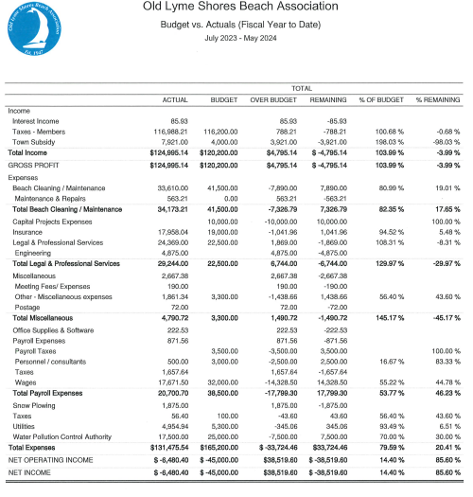

Slide 8
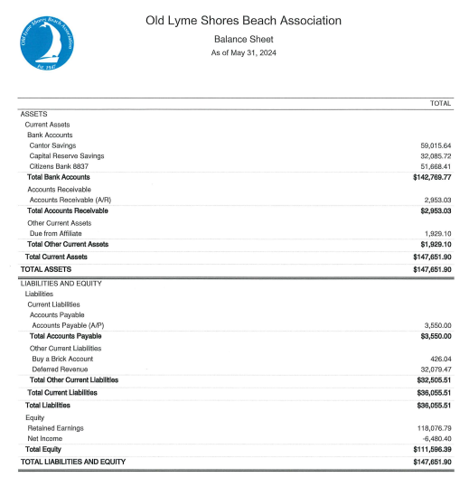

Slide 9
High-Yield Interest Rate for OLS Following 3-20-2024 BOG Vote

Slide 10
How Should Our Budget Be Funded?
$90,000 depleted from savings in recent years: From about $150,000 in June 2018 to about $60,000 as of July 1, 2024
$90,000 used to fund several annual budgets, which kept mill rate and taxes artificially low: this money could have been used for infrastructure repairs and replacements, and to build a proper capital reserve fund
Funding from savings is not sustainable; better fiscal management is 100% from revenue

Slide 11
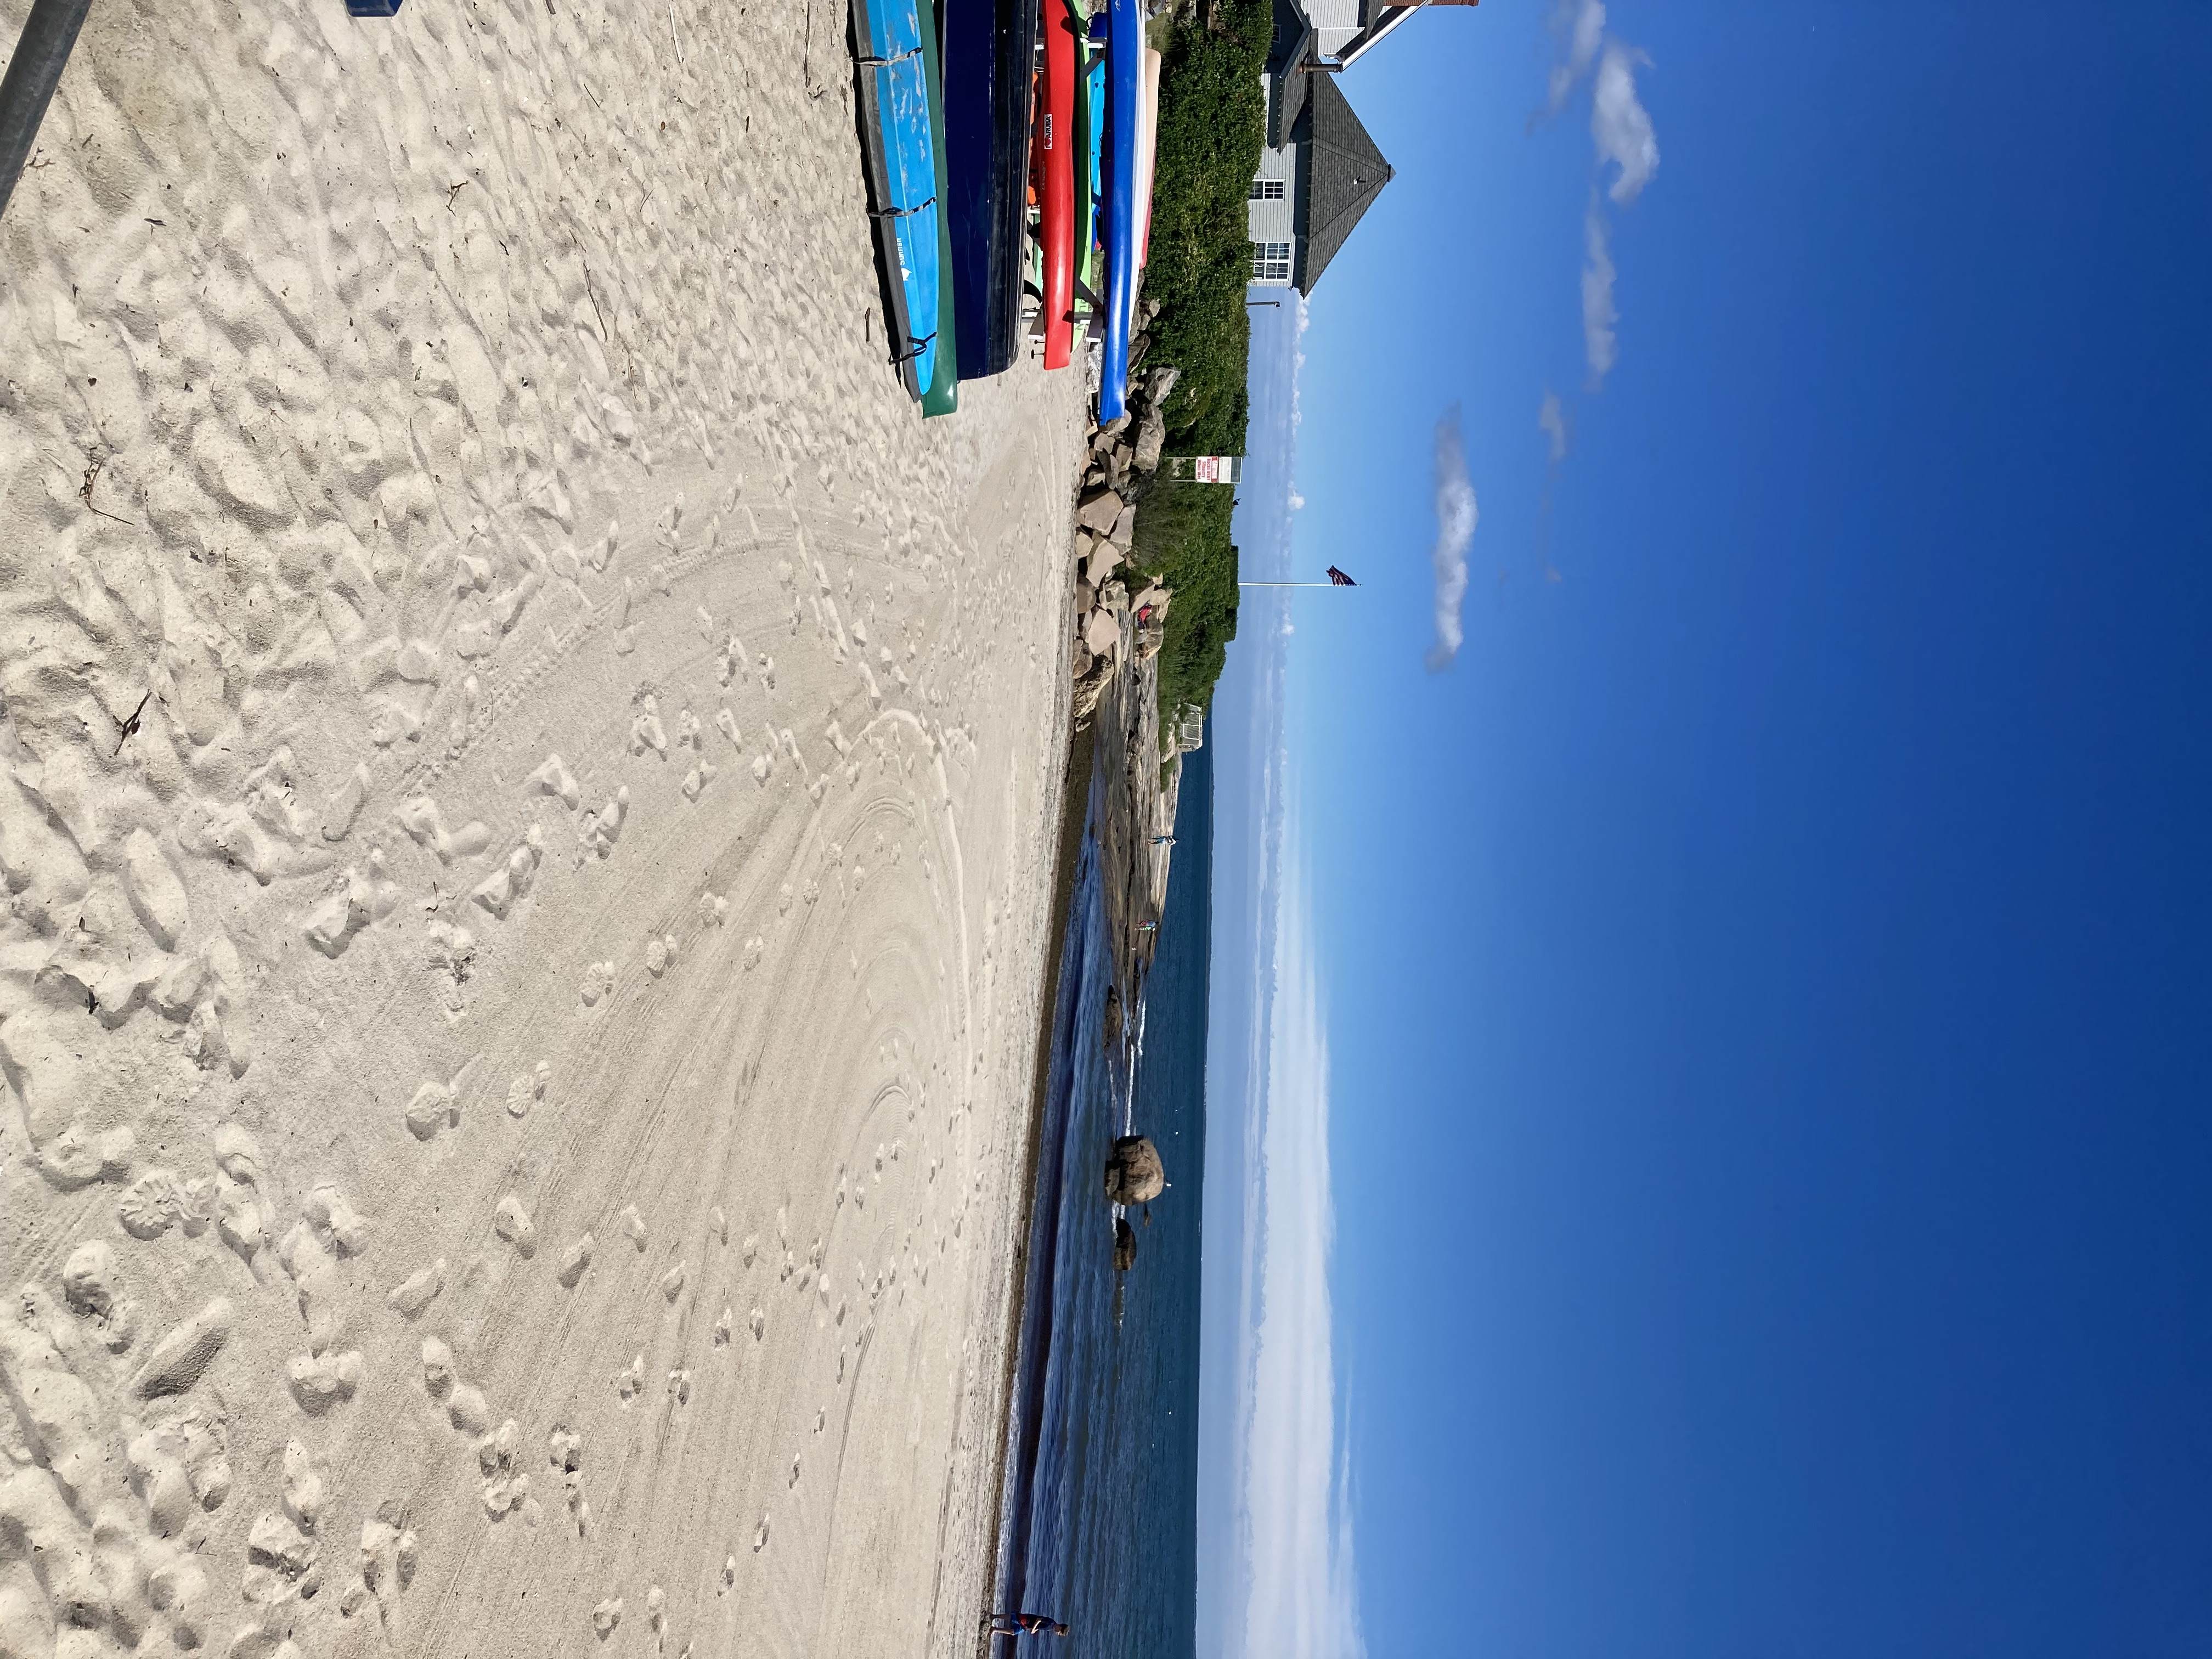
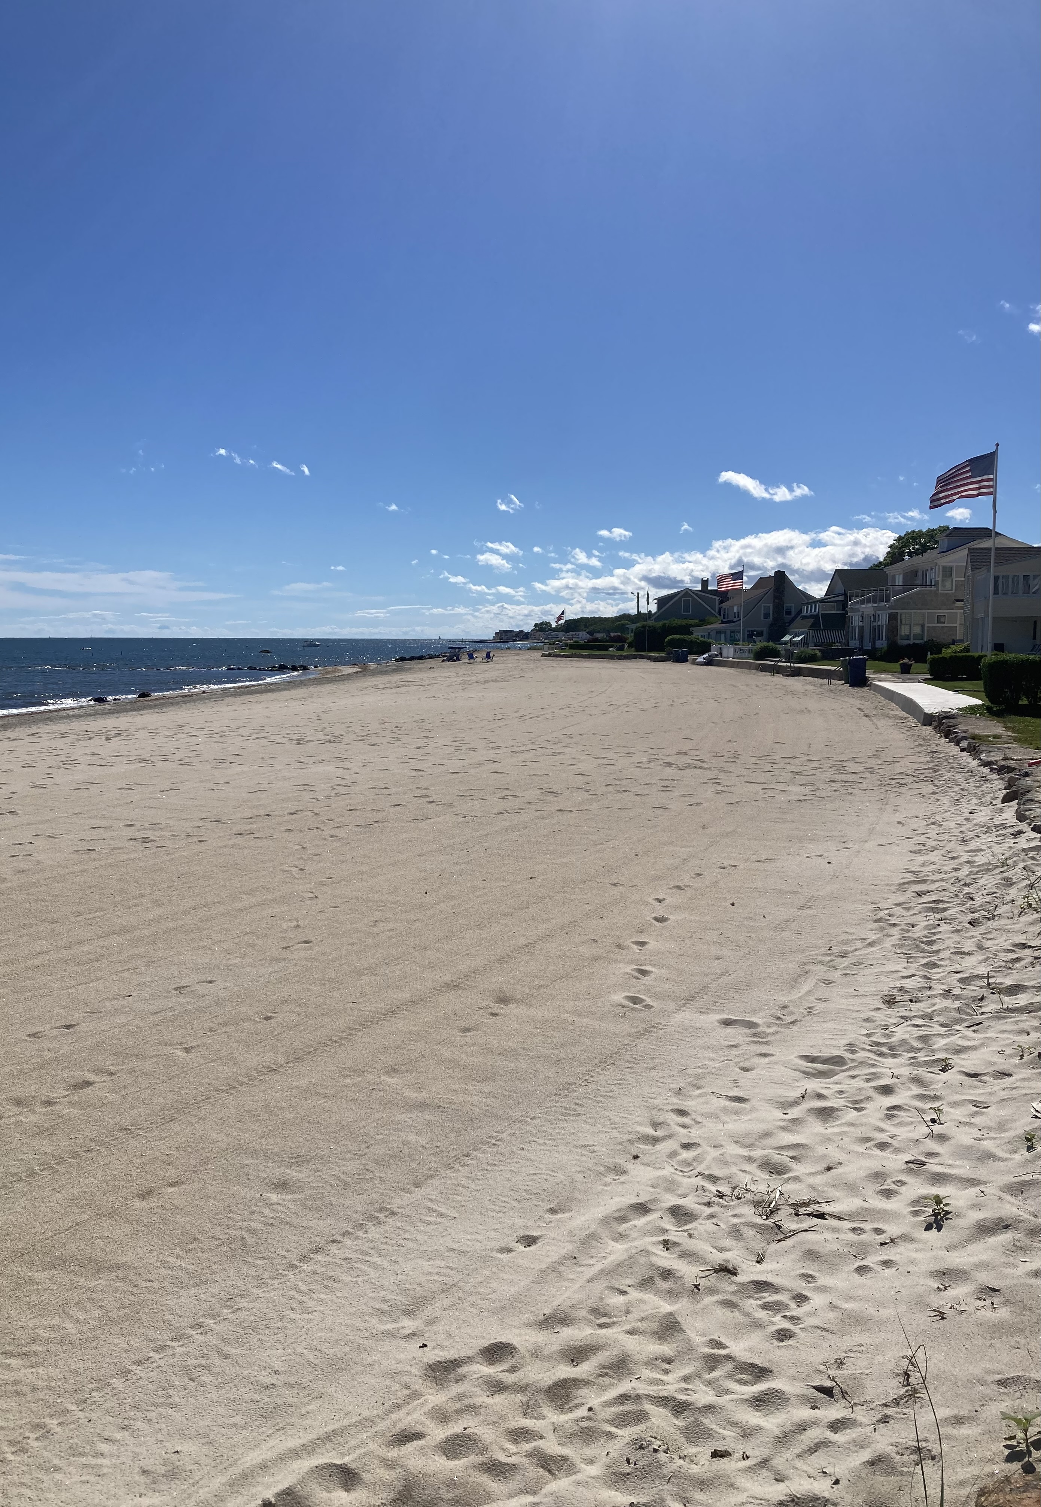
What Are the Most Significant Costs in Our Budget?
• $45,000 for maintaining the beach, including beach cleaning, sand movement and removal, storm clean up.

Slide 12
What Are the Most Significant Costs in Our Budget?
$32,500 for Water Pollution Control Authority (WPCA)

Slide 13
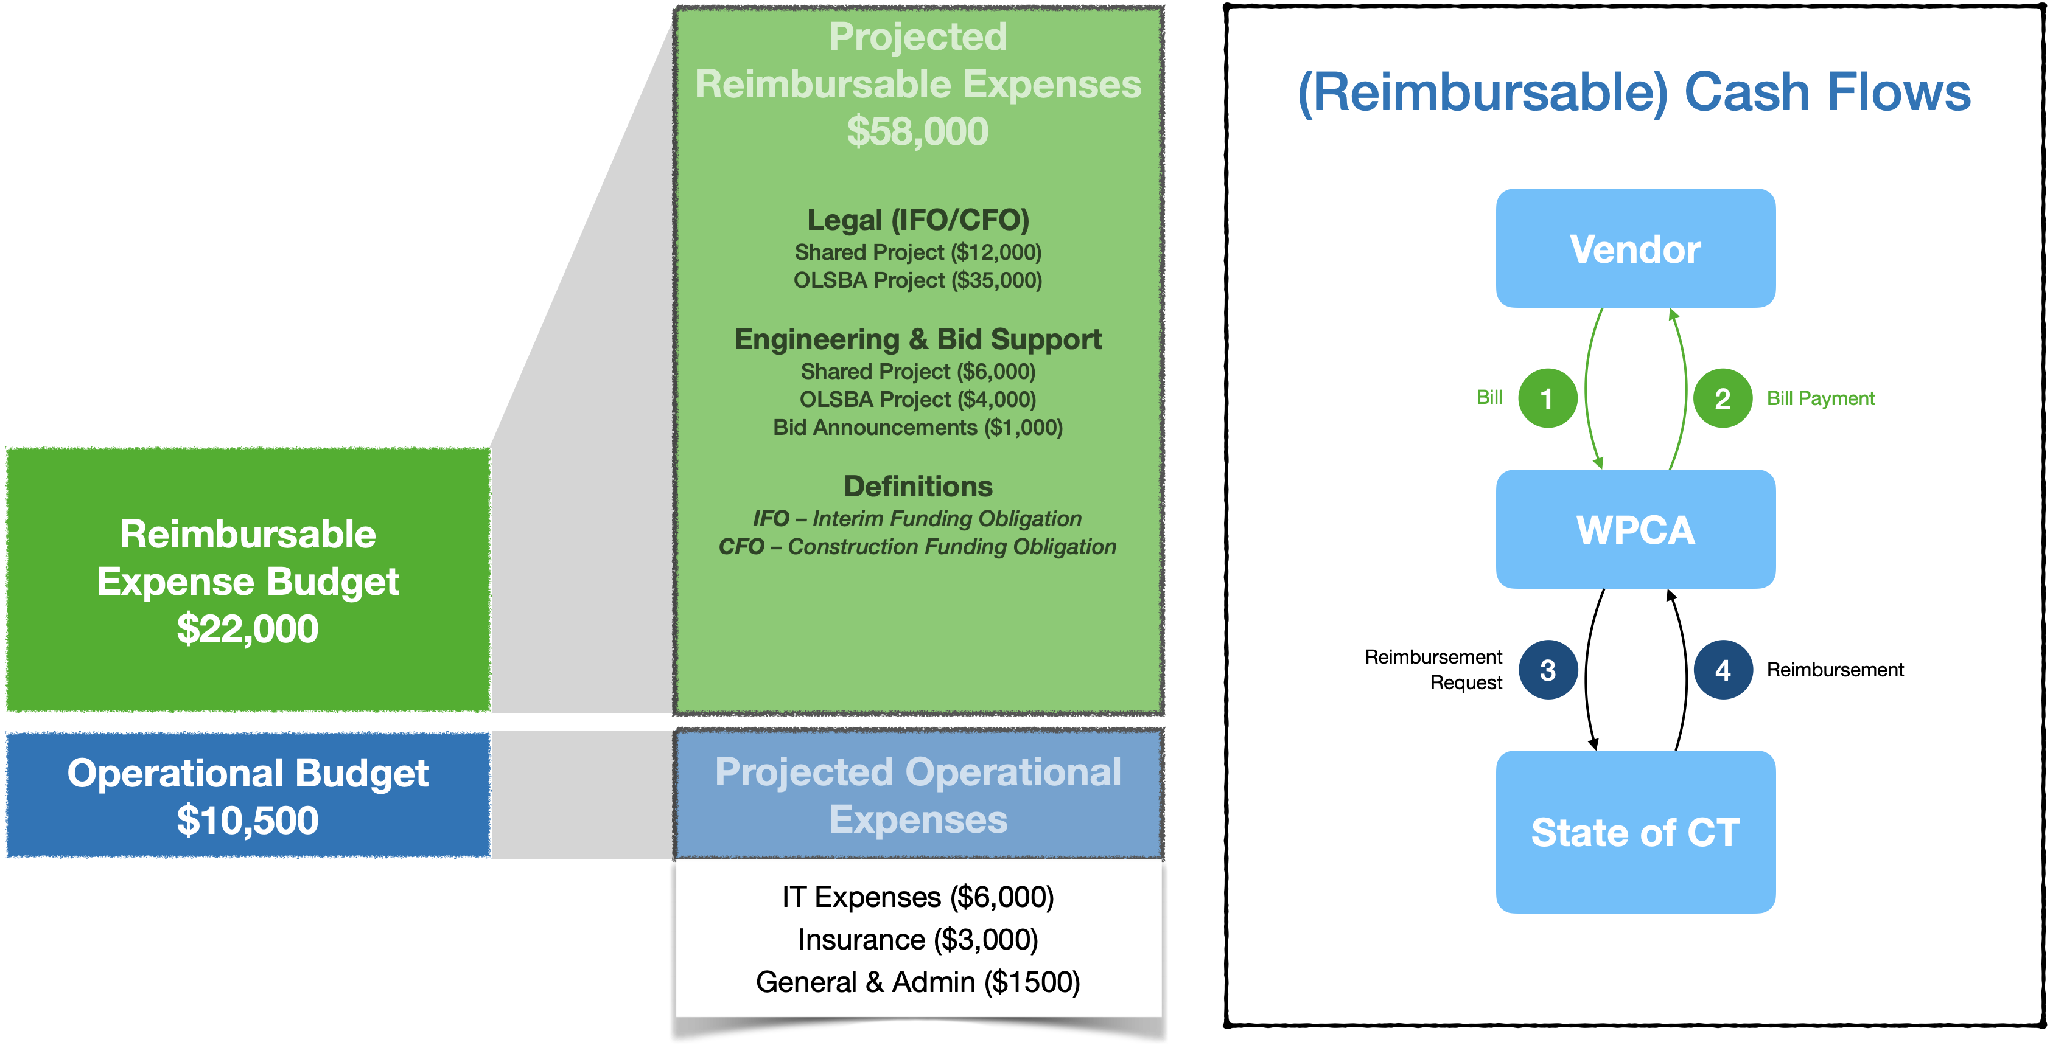
WPCA Budget Summary
Summary:
Spending Plan: $10,500 / $55 per EDU
Liquidity Facility: $22,000 / $115 per EDU
Total Allocation: $32,500

Slide 14
What Are the Most Significant Costs in Our Budget?
$15,000 for Capital Projects/Expenditures - Capital assets passed their useful life years ago. REPAIR AND REPLACE MOST SERIOUSLY FAILED AND FAILING ASSETS THIS YEAR AND NEXT; ESTABLISH AND FOLLOW ROLLING 10-YEAR CAPITAL ASSETS PLAN WHICH WILL RESULT IN KEEPING OUR ASSETS IN GOOD TO EXCELLENT CONDITION, AT A LOWER ANNUAL COST STARTING IN YEAR THREE
$10,000 for the “Annual Capital Reserve” - May 22, 2024 BOG vote budget must include $10,000 each year to build the Capital Reserve Fund
Capital Reserve Fund for replacement or acquisition of capital assets, and expenses or losses that could not have been reasonably foreseen (e.g., as a result of a hurricane or lightning strike)
Capital Reserve Account – currently about $31,000

Slide 15
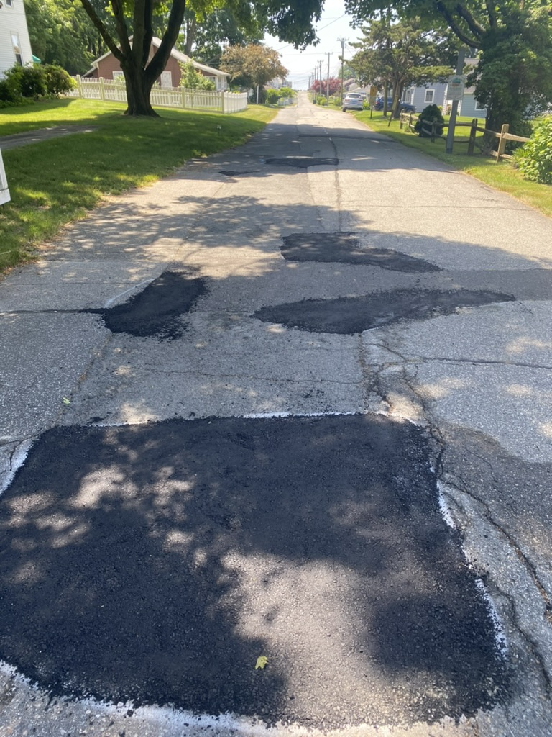
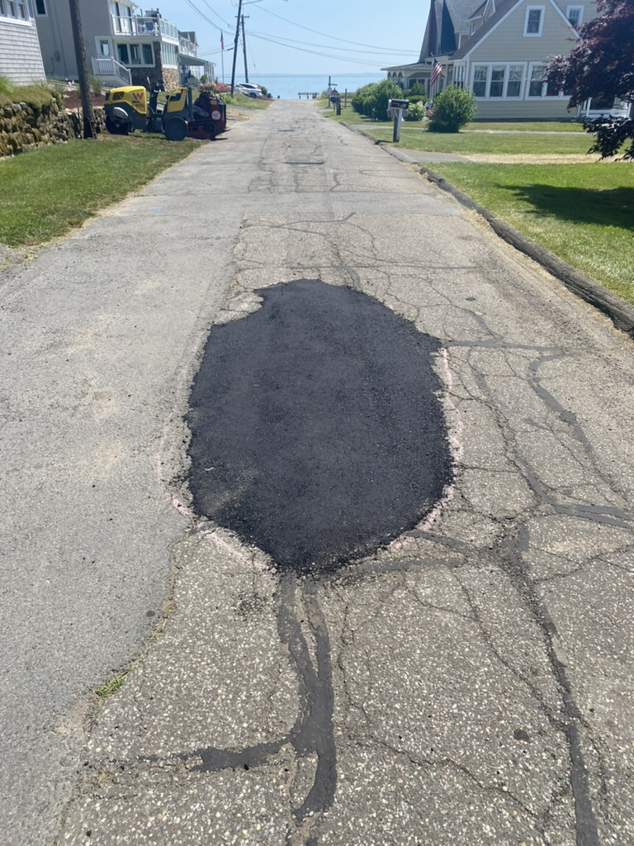
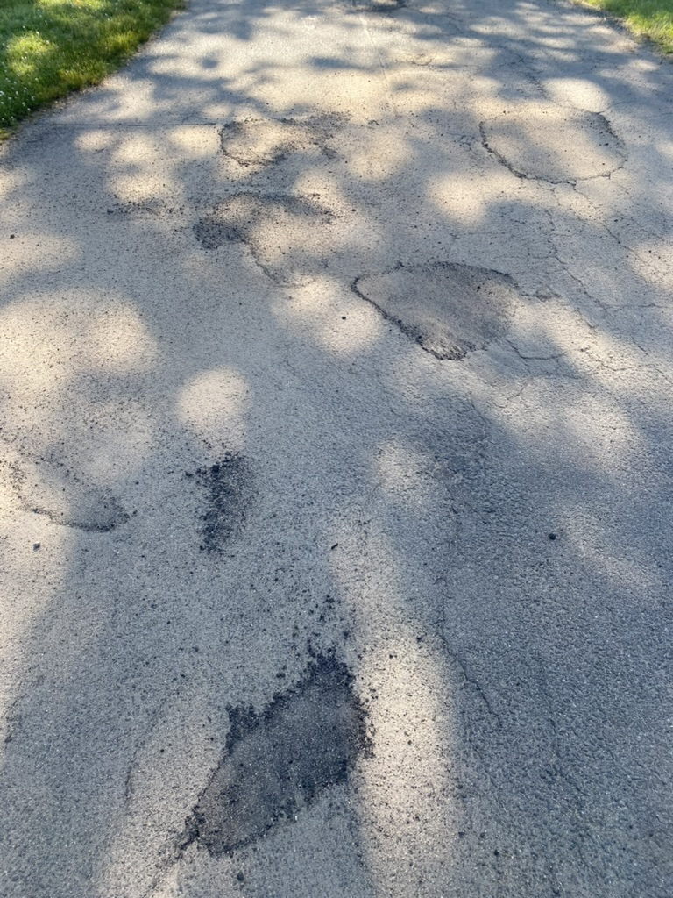

Slide 16
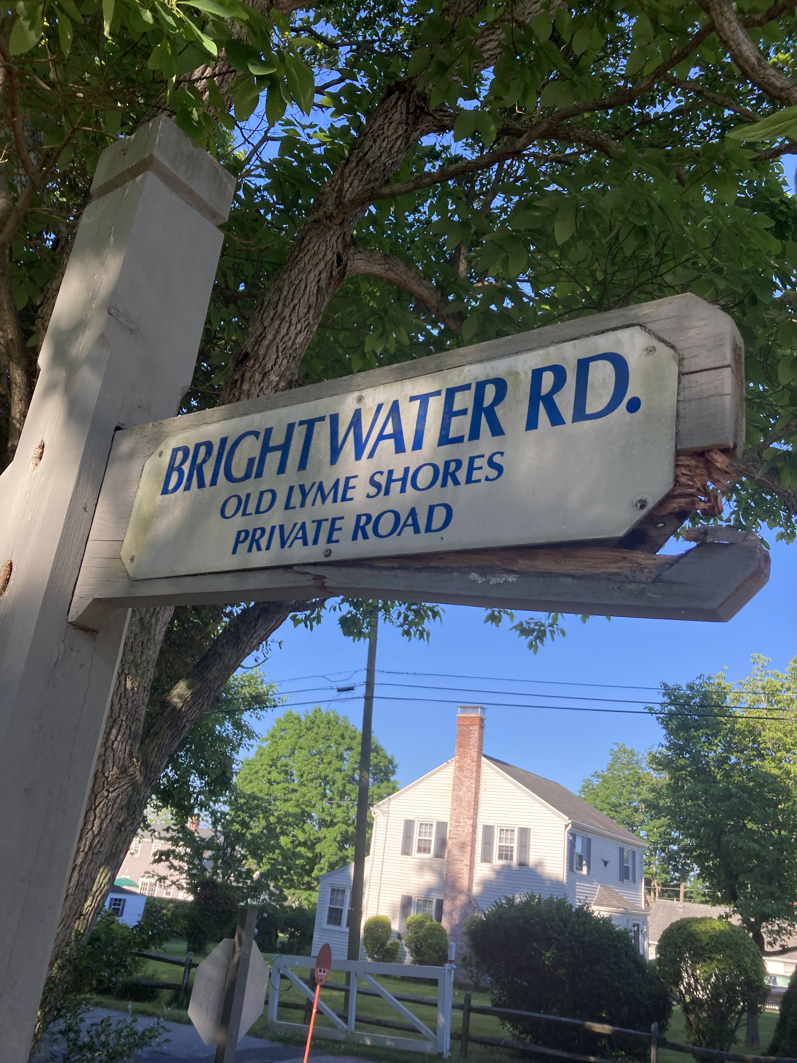

Slide 17
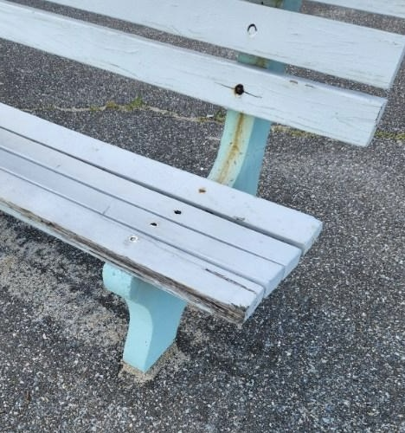

Slide 18
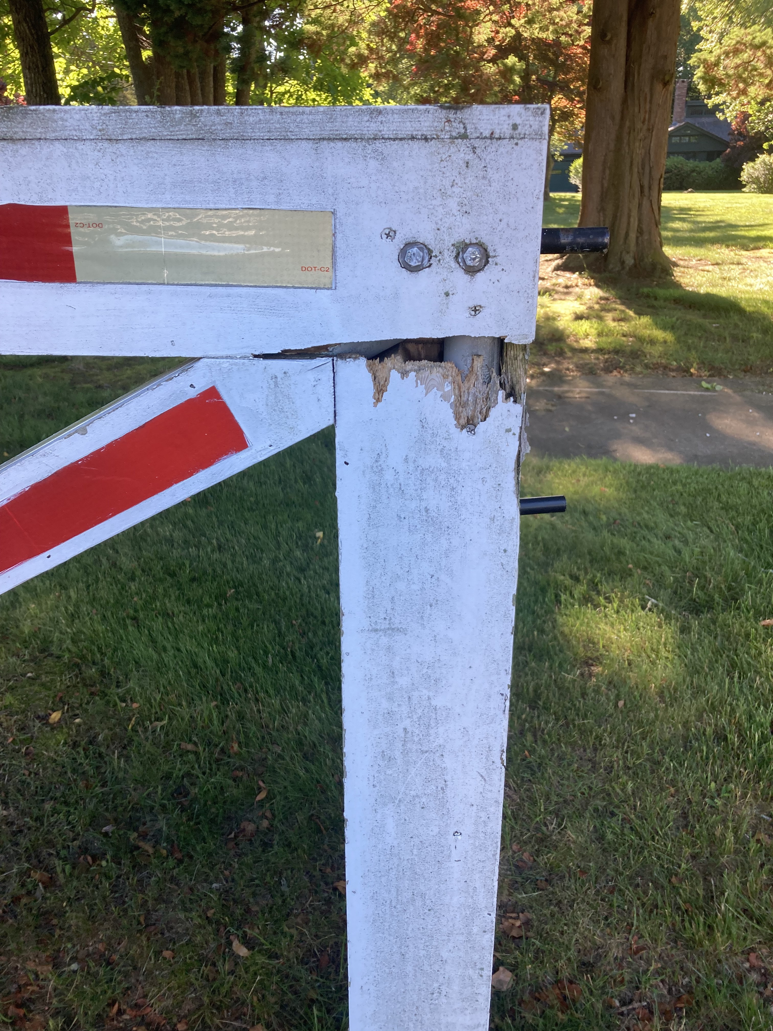

Slide 19
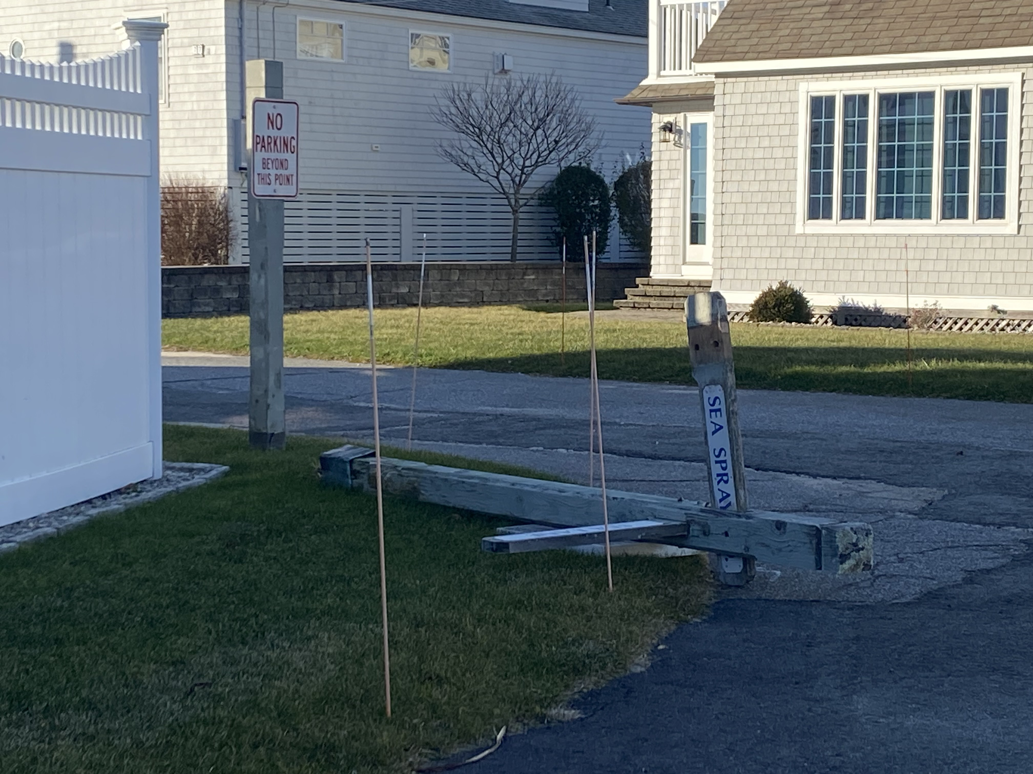

Slide 20
Infrastructure Assessment and Recommendations
Estimated ~$15K FY25 and $15K FY26, $5-10K for FY27/FY28
24 Large Street Signs estimated to be ~$500-$800 per sign
Description: 6x6 Pressure Treated Post, 6x6 Vinyl Sleeve, Street Named Sign, Labor and Installation = $12K - $19.2K estimate
32+ Stop Signs. ~$150-$200 each installed. $3000-$5000 estimate
5 Informational Bulletin Board Boxes ~$200 installed each = $1000.00
8 Concrete/Composite 3-Legged Benches @~$700.00 each = $5600.00
Entry Gates @~$1500.00 each x 8 = $12,000.00 estimate At the high end these add up to $>42,800.00 These estimates do not include street barriers/signs, radar signs, metal speed limit and children at play signs Actions:
Plan to replace Street Signs first, Benches as needed, Stop Signs as needed. Likely can’t do all street signs in one year, but by end of FY26 all Street Signs replaced

Slide 21
OLSBA Asset Identification Valuations Useful Life

Slide 22
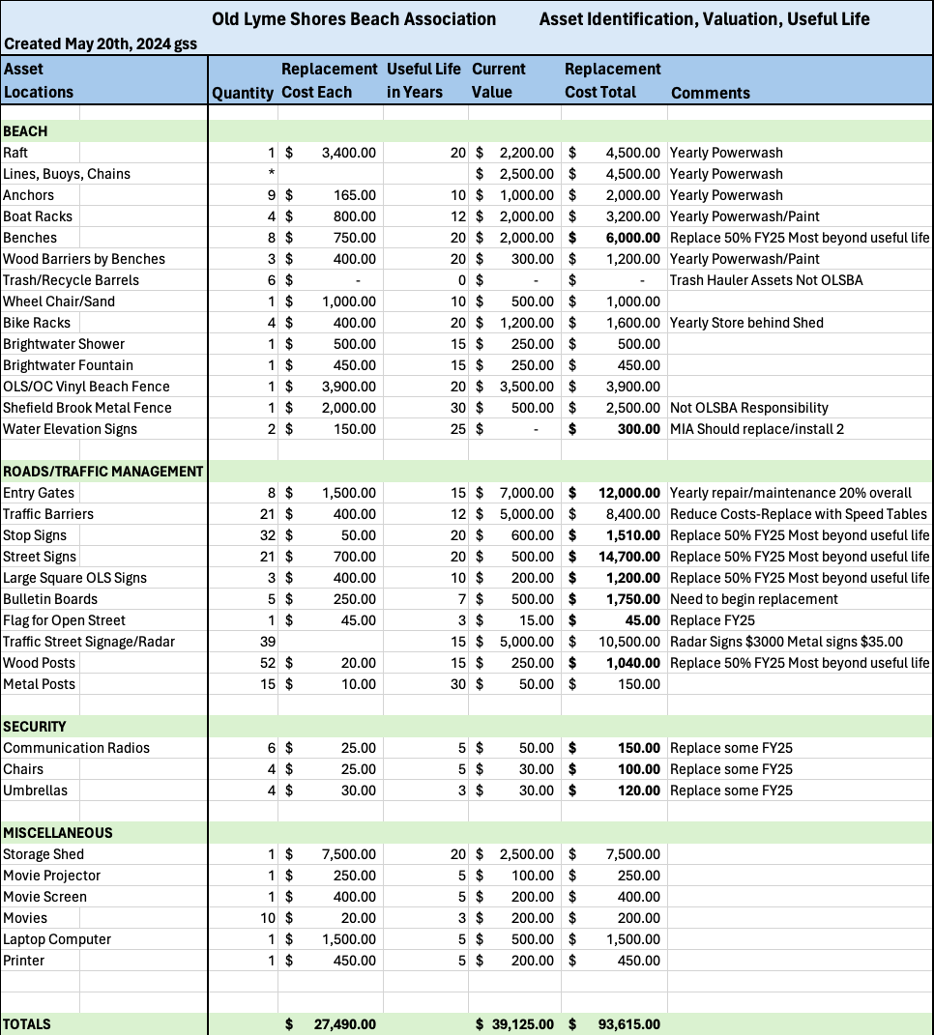
Recommendation: Invest in New Infrastructure; Road Signage in FY25-FY26 ~$15,000.00 per Fiscal Year- Replace Road and Traffic Related Signage and our Beach Benches. These expenses reduced significantly FY27-FY28, given refreshed most of community's signs and benches.

Slide 23
What Are the Most Significant Costs in Our Budget?
$28,500 for gate and beach attendants
$3,000 for professional security service evening coverage for OLS on the July 4th and Labor Day holidays, and weekends through Labor Day
$5,000 for miscellaneous expenses which potentially includes neighborhood security cameras

Slide 24
Security

Slide 25
Security & Safety
Summer security for beach
Beach & Gate Attendants (Erik Bird - lead)
Process for entry to Old Lyme Shores
Road Closure Schedule - 1 Gate Open Weekends
Speed Gates are placed on roads including Bellaire Road
Radar signs are operational on all 4 streets
Vandalism, theft & burglary challenges

Slide 26
Beach & Gate Priorities
Evening Security Guard on weekends and holidays.
Attendants ensuring that residents, guests are properly vetted before entering Old Lyme Shores and a log kept
Attendant at Brightwater AND Saltaire rather than 2 at Saltaire for the summer. This will ensure full beach coverage.
Safe driving within speed limit - ALL residents of Old Lyme Shores have a stake in this.
Keeping gates properly positioned.
Helping the attendants when difficult situations arise.
Friday evening beach movies start July 12 & weekday REC program start July 9. Schedule to be posted on bulletin boards, website and Facebook page.

Slide 27
Security Recommendations from Old Lyme PD
Corporal Wayne Collins OLPD made the following recommendations after winter burglaries:
Stay vigilant as a community
Monitor and use cameras (where possible)
Use flood lights (where possible)
Report suspicious activity to the OLPD
Not mentioned by Officer Collins but helpful are interior lights on timer and motion detectors.

Slide 28
Sea Spray Road
August 2022 Roofing nails across driveway and yard
September 5th & 6th 2022 Candle & Scooter thrown through window
April 2023 threatening letter received in mail to 2 home addresses from “OLS Residents” and threatening family house on Brightwater as well
May 2024 found bullets in driveway
2016 there was a similar pattern directly across the street of objects thrown at window and a threatening letter received from “Old Lyme Residents”

Slide 29
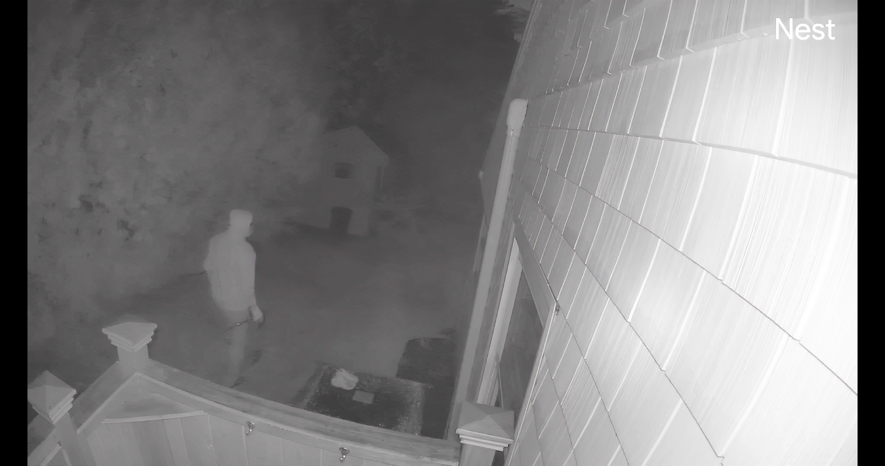

Slide 30
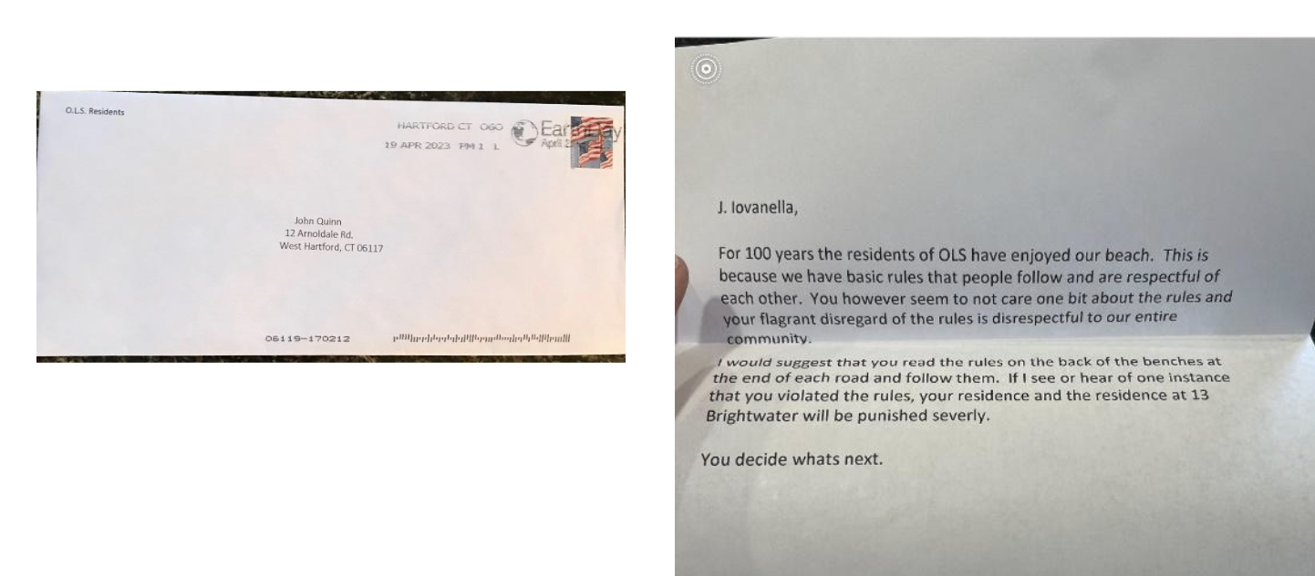

Slide 31
Community Call To Action
Anyone with information please reach out to:
Trooper Weber
matthew.weber@ct.gov
(860) 399-2100
OLPD - (860) 434-1986

Slide 32
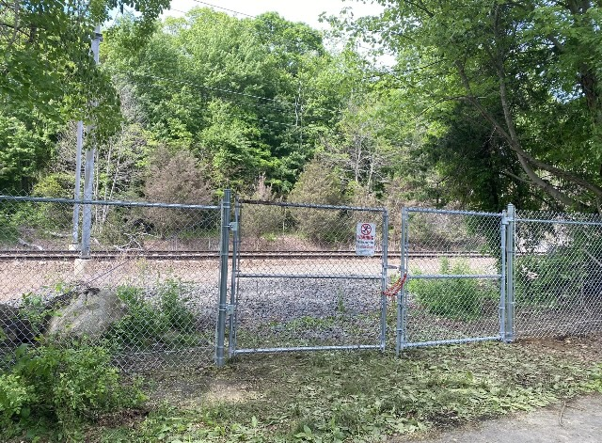

Slide 33
Are We Overtaxed at OLS?
Comparative data from the State of Connecticut for the Town of Old Lyme shows that even after increasing the mill rate to 3.1, OLS’s mill rate remains the lowest of all the beaches (Rogers Lake excluded)
Old Colony Beach Association 4.0
White Sands Beach Association 4.0
Miami Beach Association 3.5
Point of Woods Association 3.5
Old Lyme Shores Beach Association 3.1
mill-rates-fy-23-24-9192023.pdf (ct.gov)

Slide 34
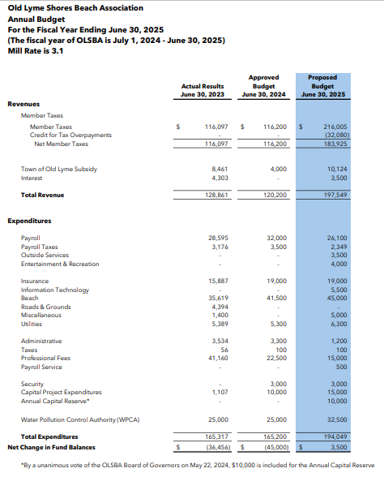

Slide 35
FINANCIALS
Q and A

Slide 36
BUDGET AND MILL RATE VOTE

Slide 37
Nominating Committee

Slide 38
Nominating Committee
Board of Governors Term Expires at Annual Meeting In
Jay Moynihan* 2024
MaryKate Reynolds 2024
Kathi Stickley** 2025
Scott Rottinghaus* 2025
John Mandracchia 2026
Greg Symon* 2026
*Appointed by the Board of Governors to fill mid-year vacancy for the seat with the
3-year term shown above.
**Resigned as of May 30, 2024
OLSBA Ball Field

Slide 39
Nominating Committee
Board of Governors Nominees 3-Year Term Expires at Annual Meeting In
Tim Larson 2025
Scott Rottinghaus 2025
Greg Symon 2026
Jay Moynihan 2027
MaryKate Reynolds 2027
OLSBA Ball Field

Slide 40
Nominating Committee
Officer Nominees* Position Outgoing Officer
Diane Duhaime President
Paul Yellen Vice President
Rob Cappellucci Treasurer & Tax Collector Norm Yester
________________ Secretary Joanne Gilland
OLSBA Ball Field
*Term is One Year for Officers

Slide 41
Nominating Committee
Committee Member Appointments – Term is One Year
Nominating Committee recommends that the Board of Governors reappointment all qualified Standing Committee members who were appointed by the Board in 2024
List of Committees and Committee Members is located at:
https://oldlymeshores.org/2024/06/committee-listing/
OLSBA Ball Field

Slide 42
Nominating Committee
WPCA Today Term Expires on June 30 In Nominee for Term Expiring on
June 30 2027
Jay Moynihan* 2024
Greg Symon* 2024
Bob Palazzo 2024
John Cunningham 2025
Paul Graml 2025
Al Roy 2026
Dede DeRosa 2026
All WPCA board seats are for 3-year terms, staggered as noted above. At least 2 shall also be members of the BOG.
*Appointed by the Board of Governors to fill mid-year vacancy for the seat with the 3-year term shown above.
OLSBA Ball Field

Slide 43
Committee Reports

Slide 44
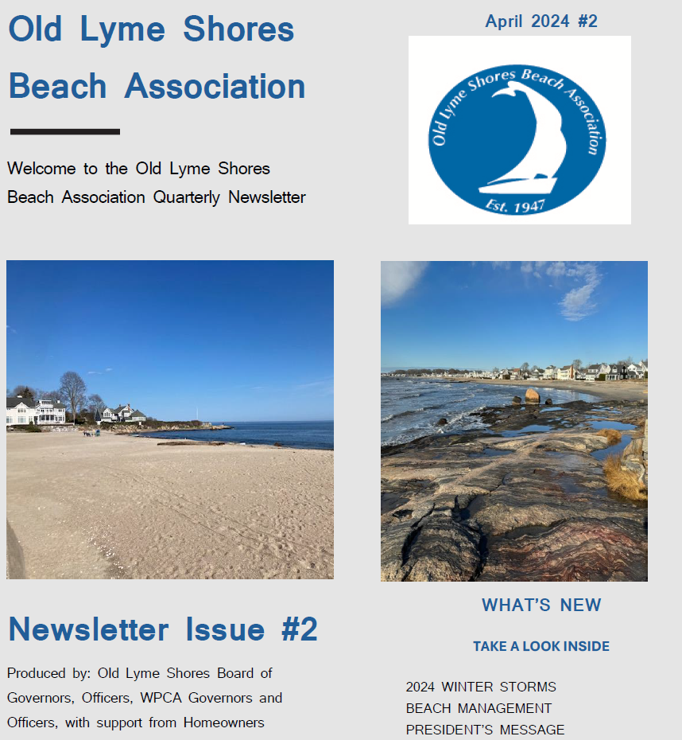
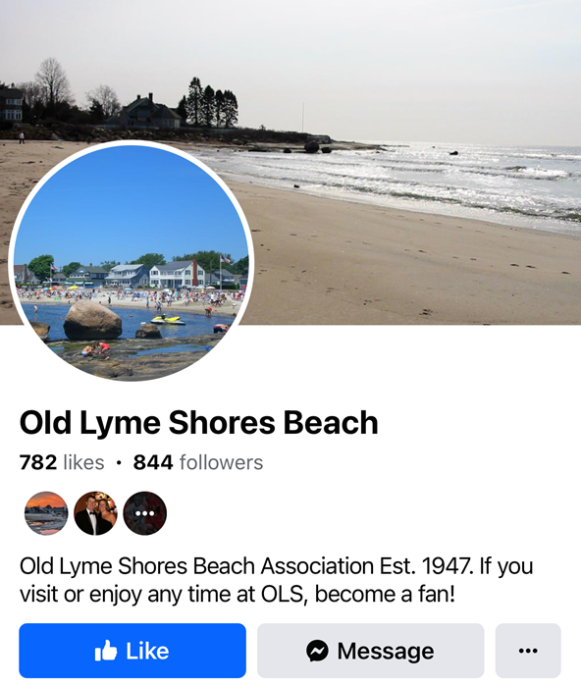
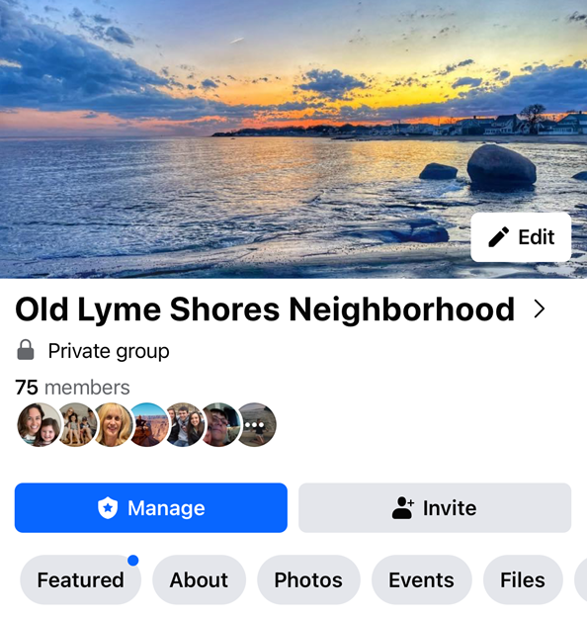
Communications
Quarterly Newsletters
Facebook
OLSBA Ball Field
OLS Website: oldlymeshores.org

Slide 45
Water Pollution Control Authority (WPCA) Sewer Project Update

Slide 46
Infrastructure Elements
Mandated Sewer Installation
Roadway Repair, Enhancement, and Safety Improvements
Stormwater Management Improvements
WPCA Update
Unified Infrastructure Project

Slide 47
WPCA Update
General
DEEP Consent Order
August WPCA Special Meeting
Agreements
Town of Old Lyme & Cost Sharing Agreement
New London Agreement
Design
Town of Old Lyme & Cost Sharing Agreement
Potential Design Modifications to Shared Infrastructure
OLSBA Ball Field

Slide 48
WPCA Update
Construction
Projected Bid Inflation
Seeking New Bids
Financing
CT $15M Forgivable Loan Update
New Bond Resolution
OLSBA Ball Field

Slide 49
WPCA Update
Next Steps
Address and resolve issues described in this update
Conclude revisions regarding existing agreements
Schedule a Special WPCA Meeting - August
More Information
Old Lyme Shores WPCA website - oldlymeshores.org/wpca
Additional Questions and Feedback welcomed! askthewpca.g@oldlymeshores.org
OLSBA Ball Field

Slide 50
Resident Comments 3 Minutes per Resident Adjournment

Slide 51
Old Lyme Shores Beach Association
Annual Spring Meeting
Saturday, June 15, 2024 – 10:00 am
Old Lyme Middle School Auditorium

