Slide 1
OLSBA Typical Septic System Abandonment & Water and Sewer Hookups
September 1, 2019

Slide 2
WPCA
Old Lyme Shores WPCA has incorporated into the projected costs of our Sewer Project, the individual costs to abandon our individual Septic Tanks and to provide new connections for sewer and water service
Conn Public Health code (Section IID) requires “Abandonment of subsurface sewage disposal system components (i.e. septic tank, hollow leaching structure) or cesspool shall be performed is such a manner as to eliminate the danger of inadvertent collapse of the component or cesspool. The responsibility for abandonment lies with the property owner. Structures that are to be abandoned shall be emptied of all sewage prior to abandonment Structures shall be filled with sand, gravel, or crushed and backfilled with clean soil.”
No separate upfront payment for homeowners – included in annual sewer assessment
Provide experienced contractors with established protocols
Eliminate need for homeowner to do separate contracting
Supply consistent acceptable documentation to Town Health Dept
Lower costs by contracting for the entire OLS community
Eliminates delays with separate individual contracts

Slide 3
Problem with Old Septic Systems
Connecticut Public Health Code states responsibility lies with the property owner to eliminate the danger of inadvertent collapse ¹
Forgotten septic tanks, hollow leaching structures, cesspools, and drywells present serious hazards including cave-in or collapses and asphyxiation hazards.
It is unwise to leave a potentially lethal hazard and personal liability unaddressed at your property.
¹ Public Health Code Technical Standards for Subsurface Sewage Disposal Systems - Section IID

Slide 4
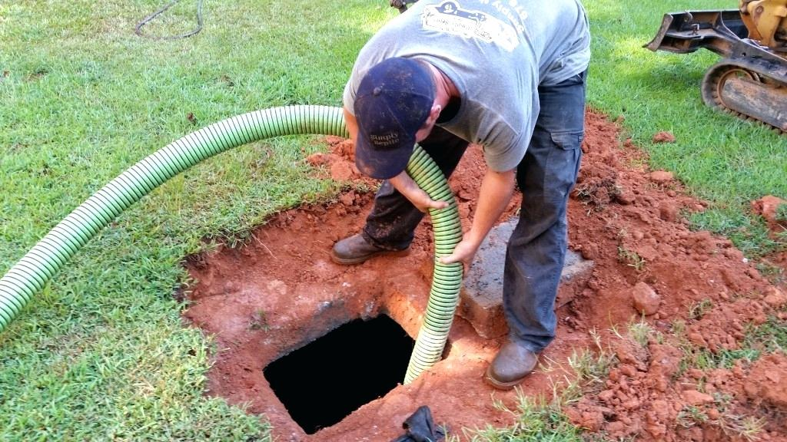
What is the OLSBA WPCA to do?
Owners shall abandon septic systems when a public sewer becomes available
Work needs to be done by an experienced contractor who knows proper safety procedures
Pumping septic system waste into a public sanitary sewer system is prohibited

Slide 5
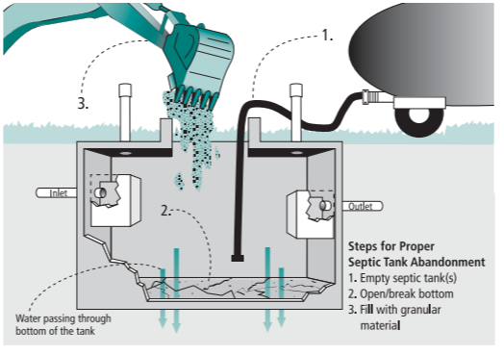
Quick Reference - Septic System Abandonment
Source: onsiteinstaller.com

Slide 6
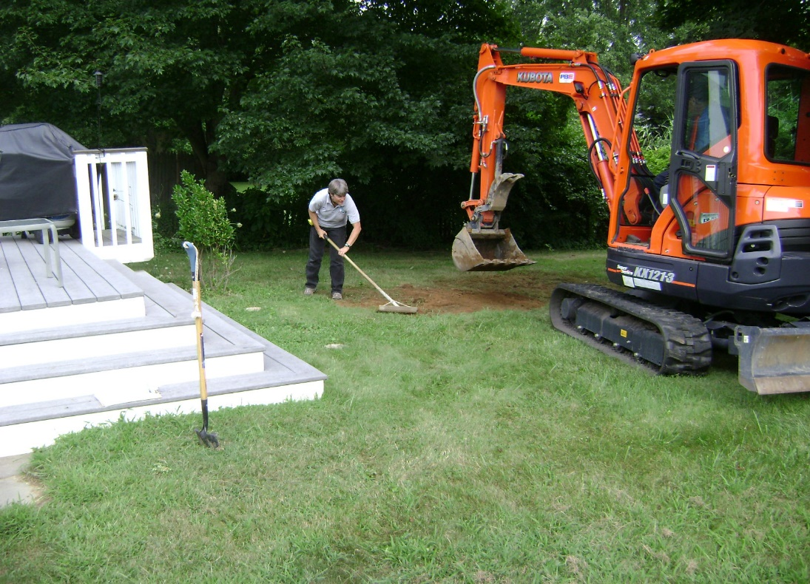
Best Practices for Septic System Abandonment
Notify WPCA and Local Health Department (Ledge Light Health District) as required
Disconnect power at the source to all electric controls and remove all controls and panels (if applicable)
Pump out the septic tank and any hollow structures by a Licensed Septic Hauler. Do not pump the contents into a public sewer
Remove tank cover
Rupture bottom of structure (after pumping) to prevent retainage of water
Take photo of structure (before filling)
Fill structures with sand, gravel, flowable fill, or crush & backfill with clean soil
Take second photo after filling extends to the top of sidewalls
Use sand, aggregate, and soil from mound to fill the tanks if a mounded system is being abandoned
Compact material to prevent settling
Disconnect and seal all piping leading to/from the structure
Grade site and establish vegetative cover
Document the location and methods of the filled-in septic system so future site workers can anticipate these buried obstructions
Submit a copy of the pumping receipt, filled-in tank location, and photos to the Local Health Department (Ledge Light Health District) to record abandonment

Slide 7
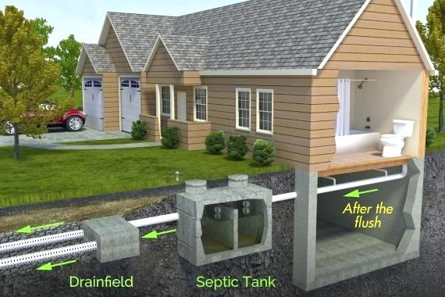
Best Practices for Septic System Abandonment
Pump out tank contents
Crush Tank Cover
Rupture tank bottom
Fill with sand or gravel & compact well
Document work with Photos, Measurements, and Receipts
Submit documentation to Local Health Department when complete
Disconnect All House Piping

Slide 8
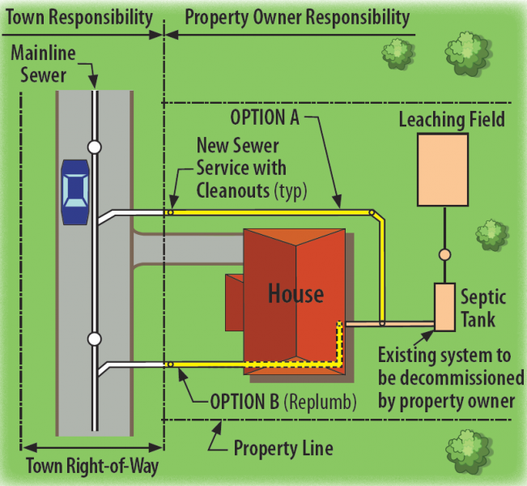
Typical Water Service and Sewer Lateral Plan OLSBA
Association Responsibility
Mainline
Water
W
10 Foot Min.
Separation
New/Replace-ment
Water Service
W
W
Water Meter
Association Right-of-Way

Slide 9
Homeowner Responsibility
How do we know where to place the water and sewer lines on your property?
Fuss & O’Neill will assist homeowners to complete the Location Form (next slides)
Map for each property will be provided for homeowner to depict preferred location
The preferred location should
Minimize disruption to plantings and driveways
Identify any other conditions or concerns

Slide 10
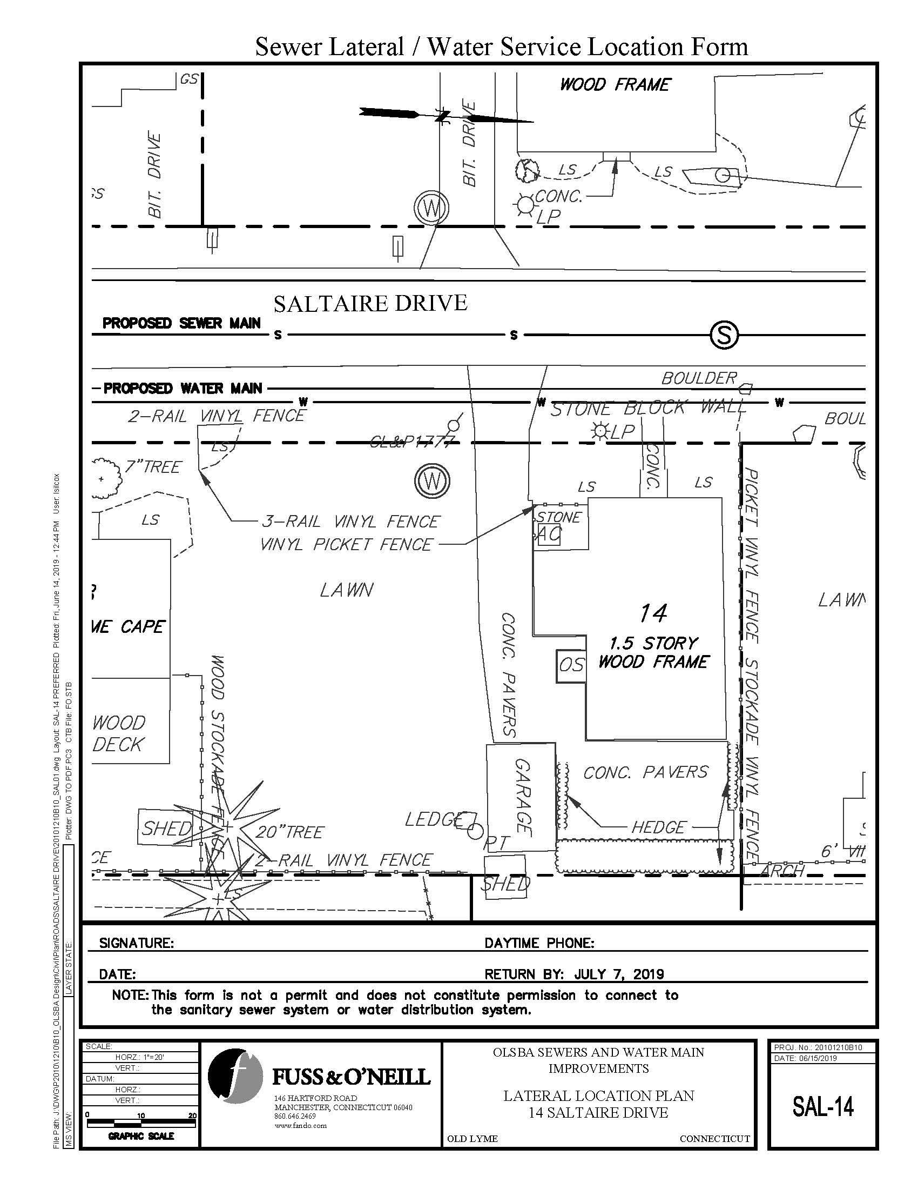
Typical Blank Lateral Location Plan

Slide 11
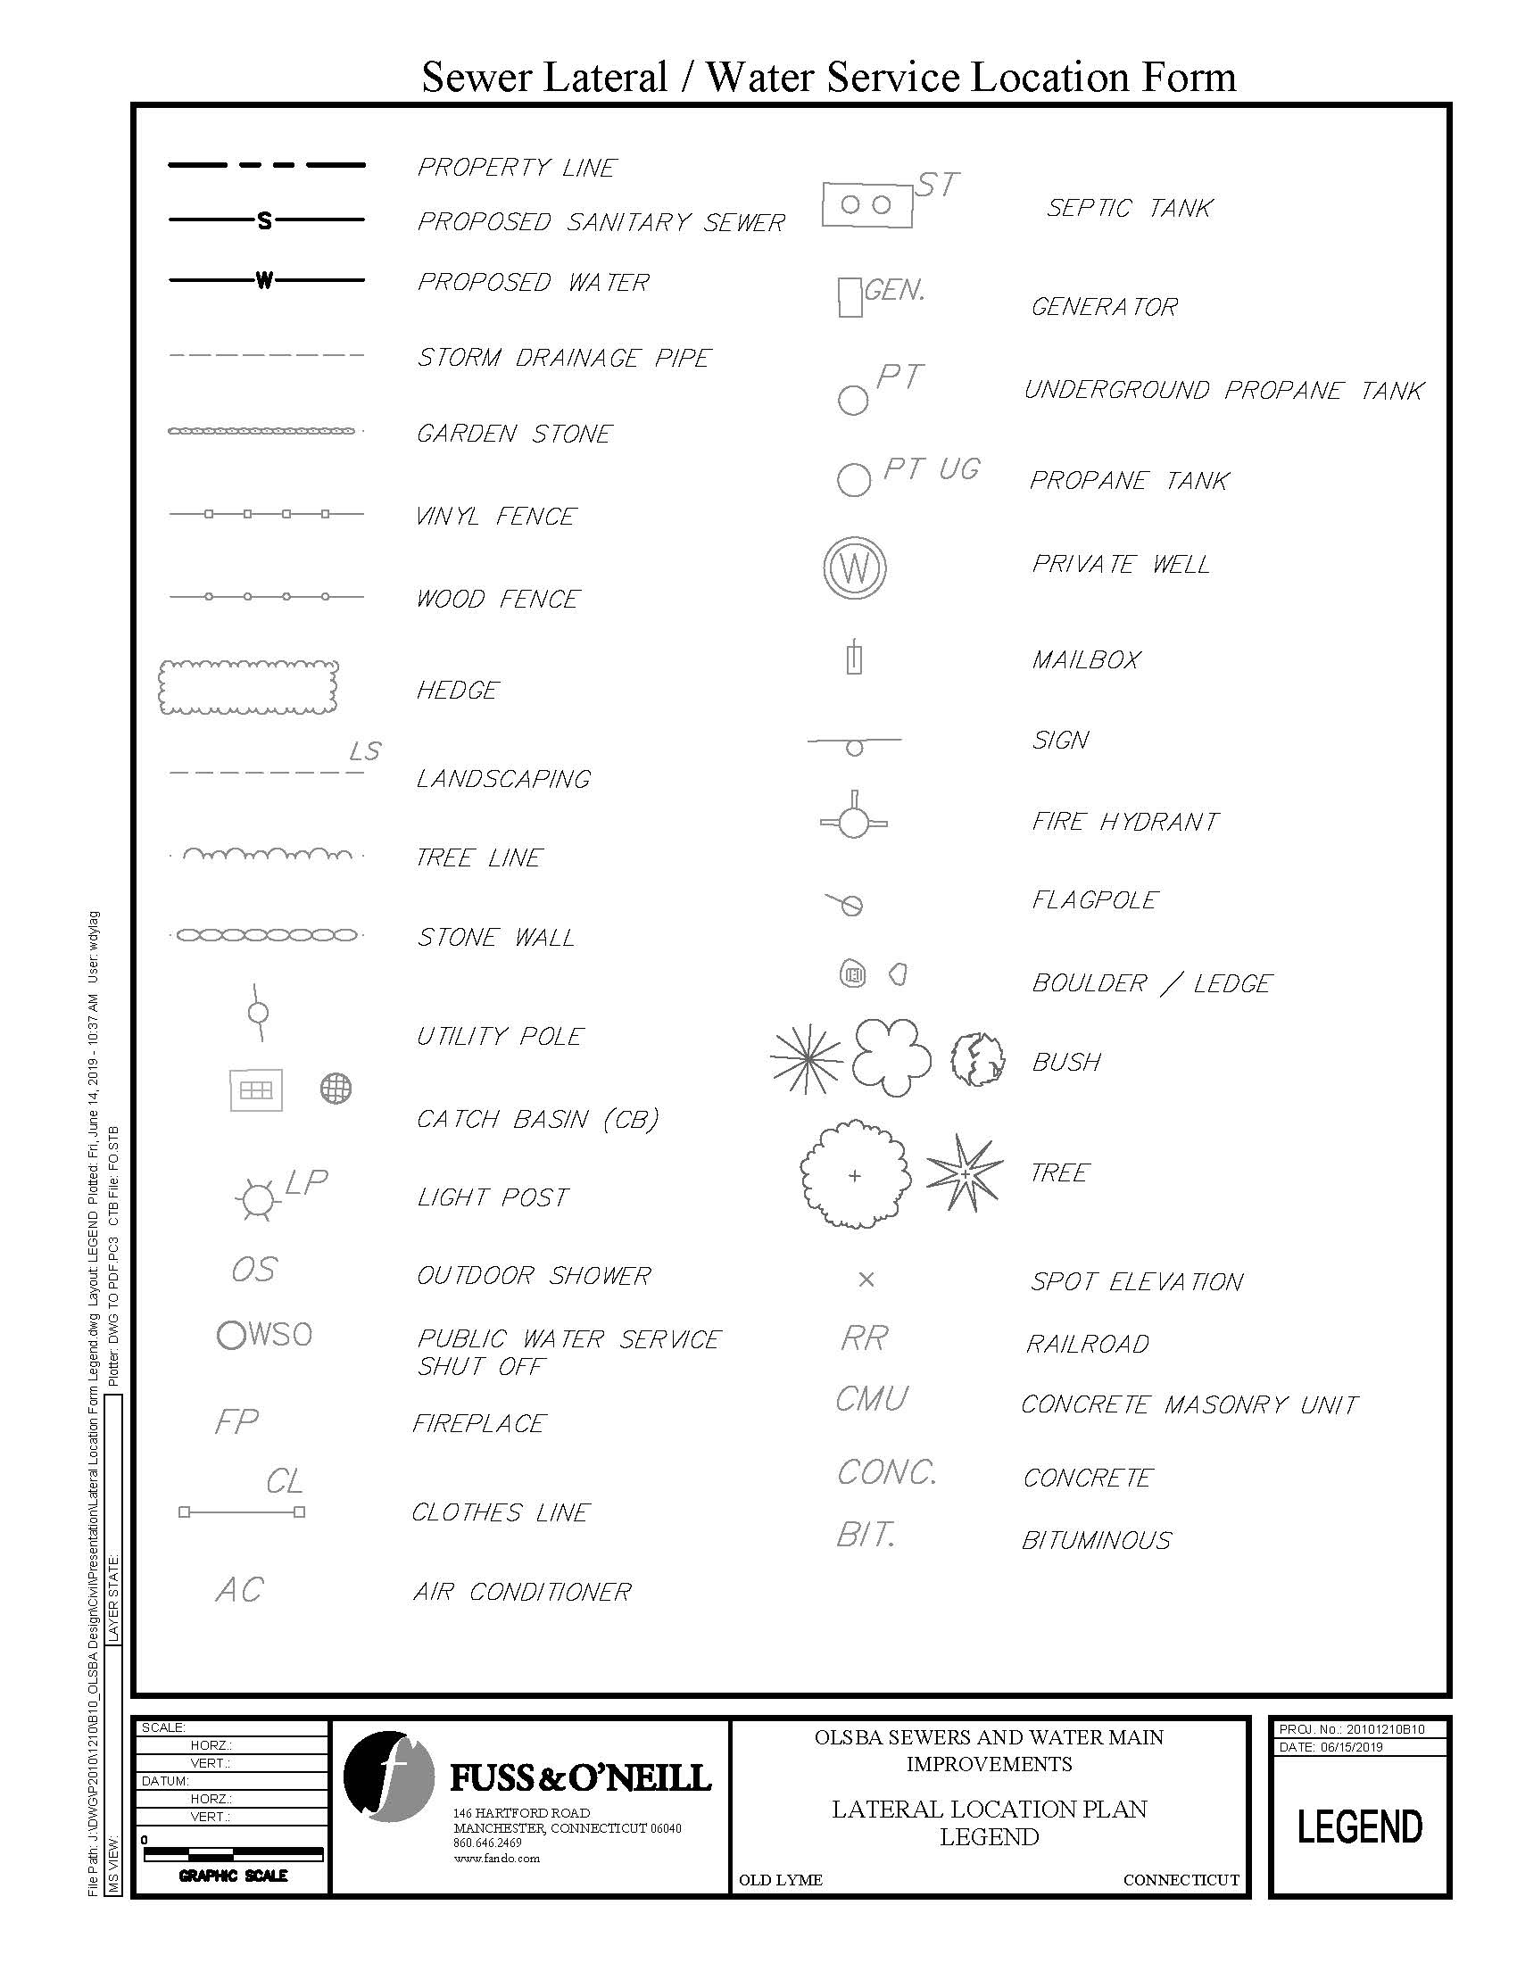
Typical Sewer and Water Lateral Location Form Legend

Slide 12
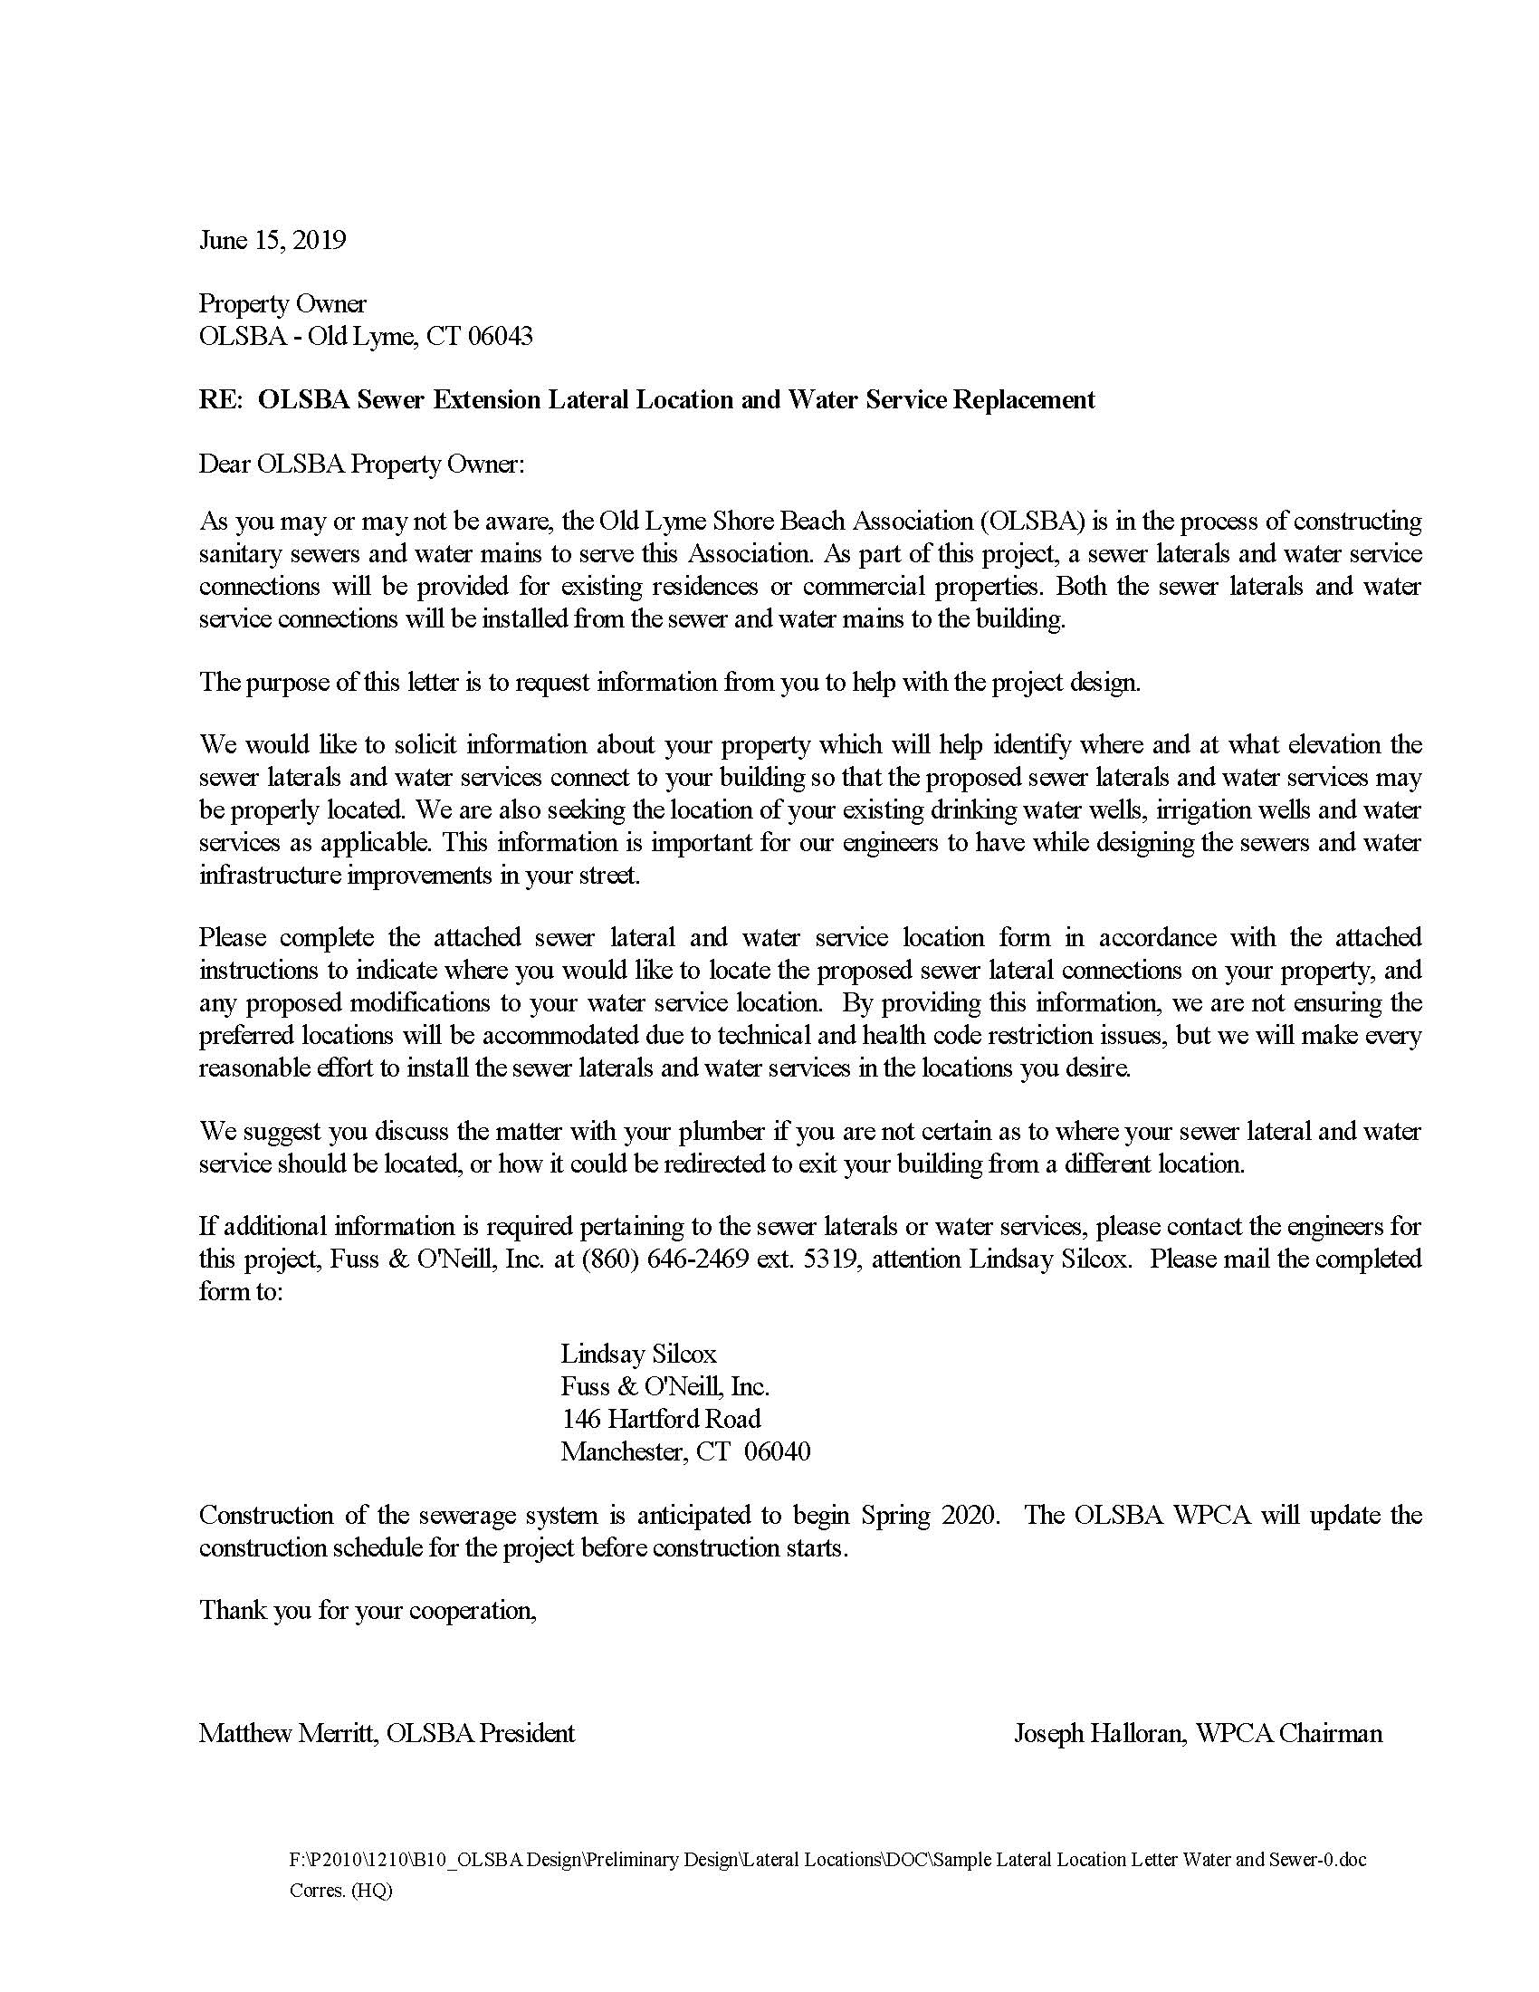
Typical Lateral Location Form Cover Page

Slide 13
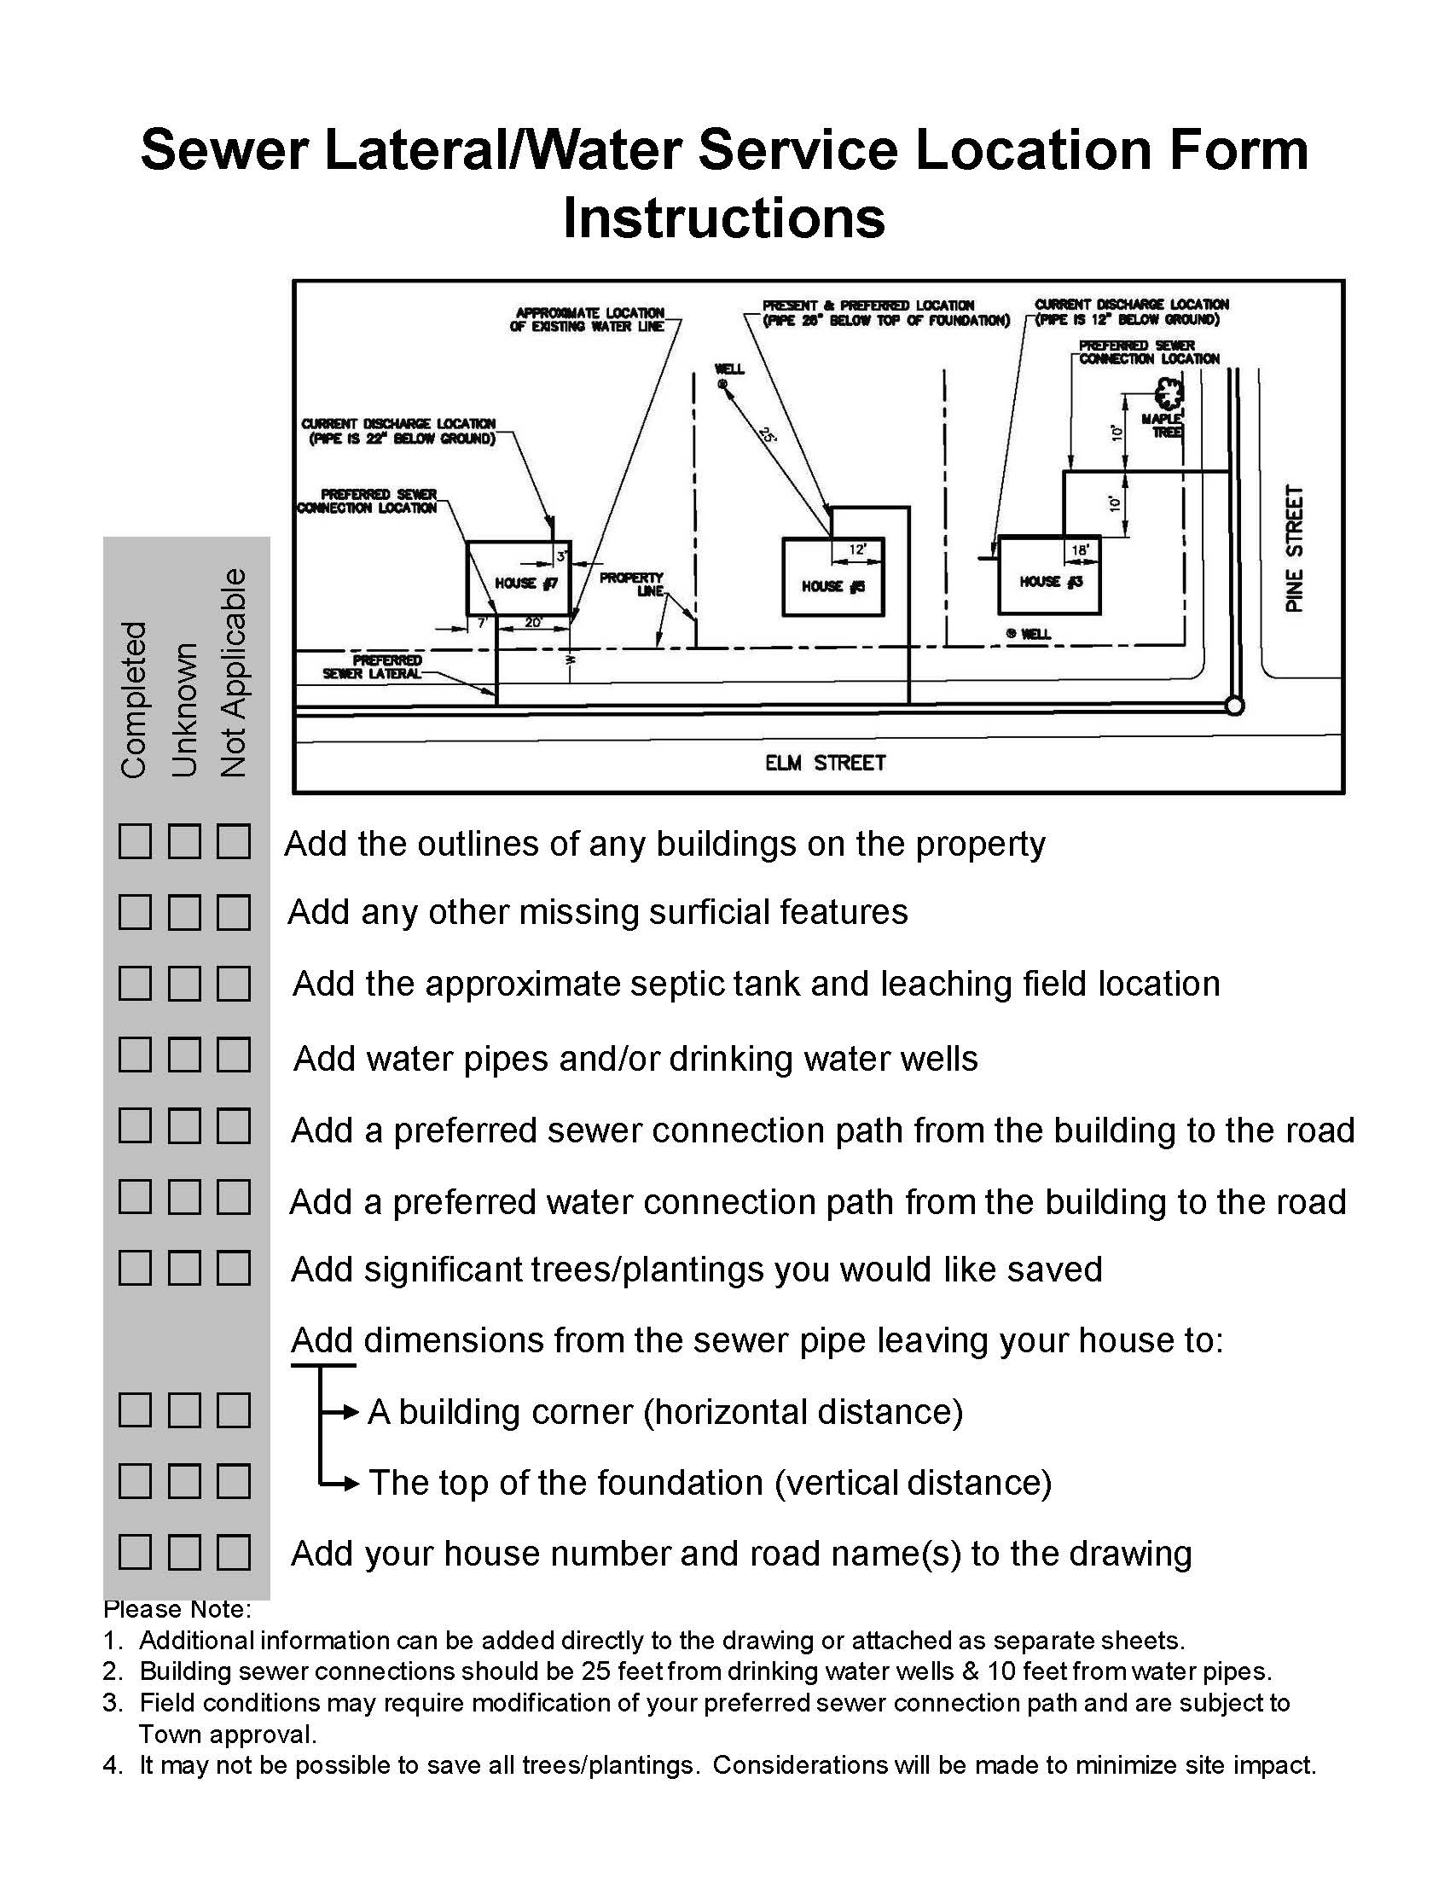
Typical Lateral Location Form Instructions

Slide 14
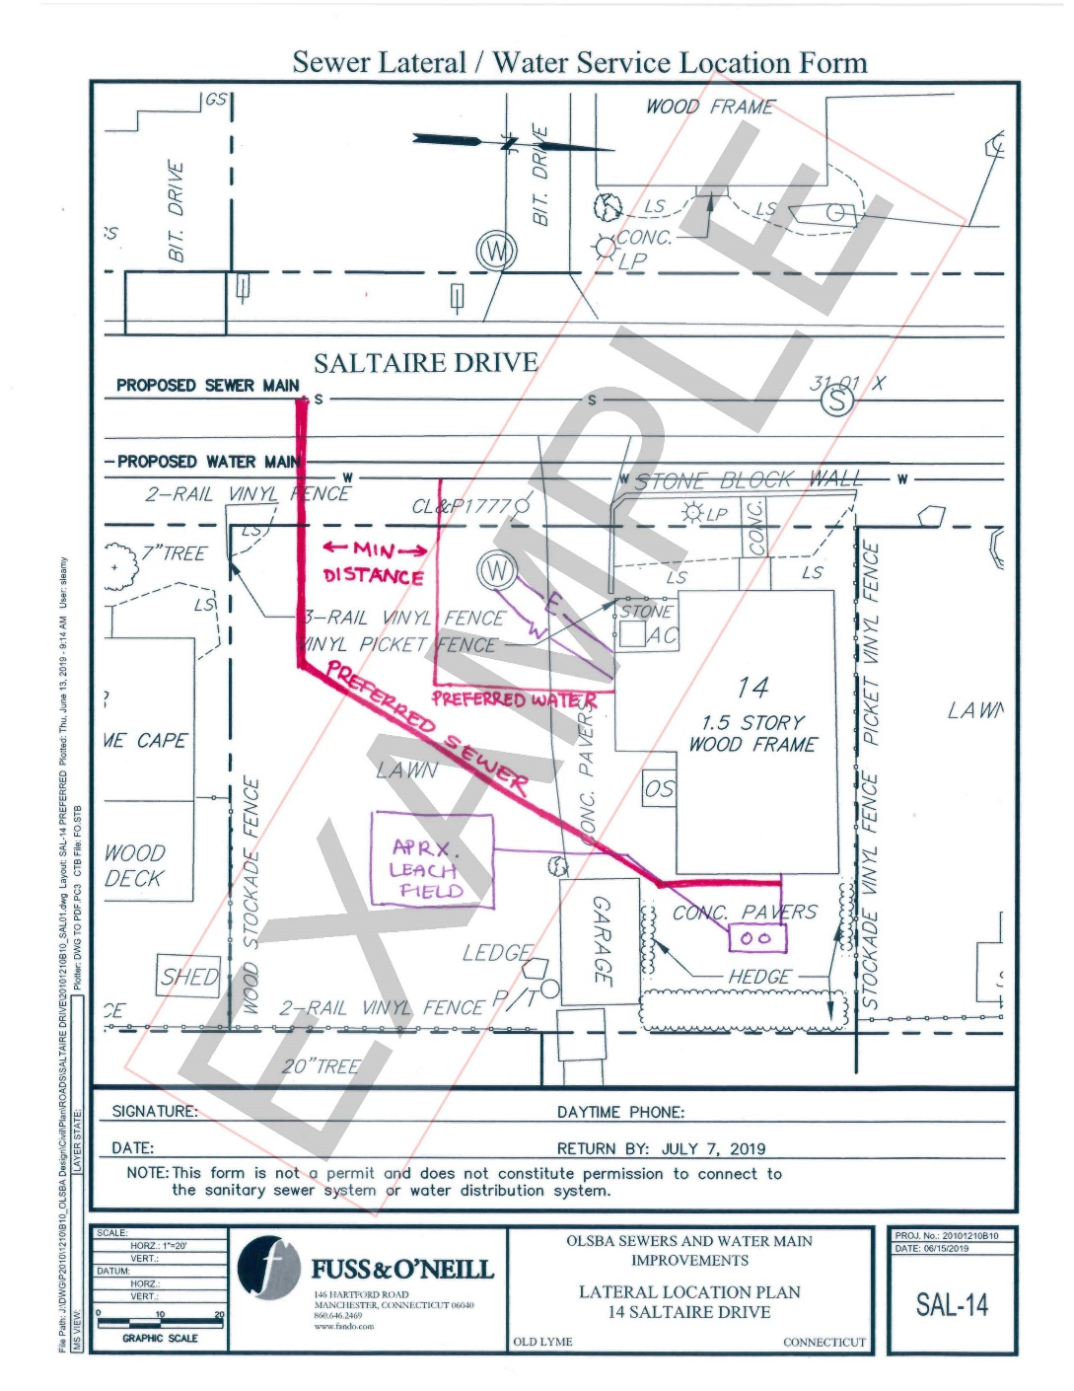
Example Sewer and Water Lateral Location Form

